Slide 1
HRI, Touche
1

Slide 2
“We have nothing to fear for the future, except as we shall forget the way the Lord has led us, and His teaching in our past history” {CET 204.1}
Notes:
This series - The story of salvation from the time of Christ to today.
How Satan has tried to destroy His efforts.

Slide 3
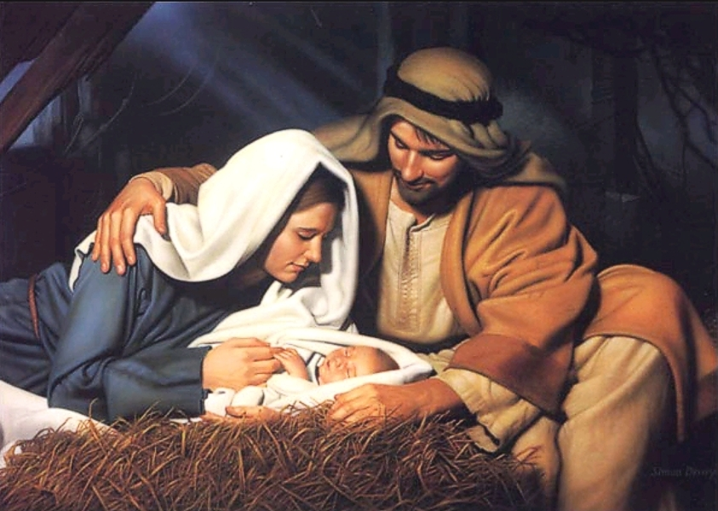
Isa 7:14 “Therefore the Lord Himself will give you a sign: Behold, the virgin shall conceive and bear a Son, and shall call His name Immanuel.
Notes:
The Messiah was predicted literally thousands of years before He came

Slide 4
Isa 53:4-7 He has no form or comeliness; and when we see Him,
There is no beauty that we should desire Him.

Slide 5
626 BC – 528 BC
Notes:
God had sent Babylon to teach his people a lesson of obedience

Slide 6
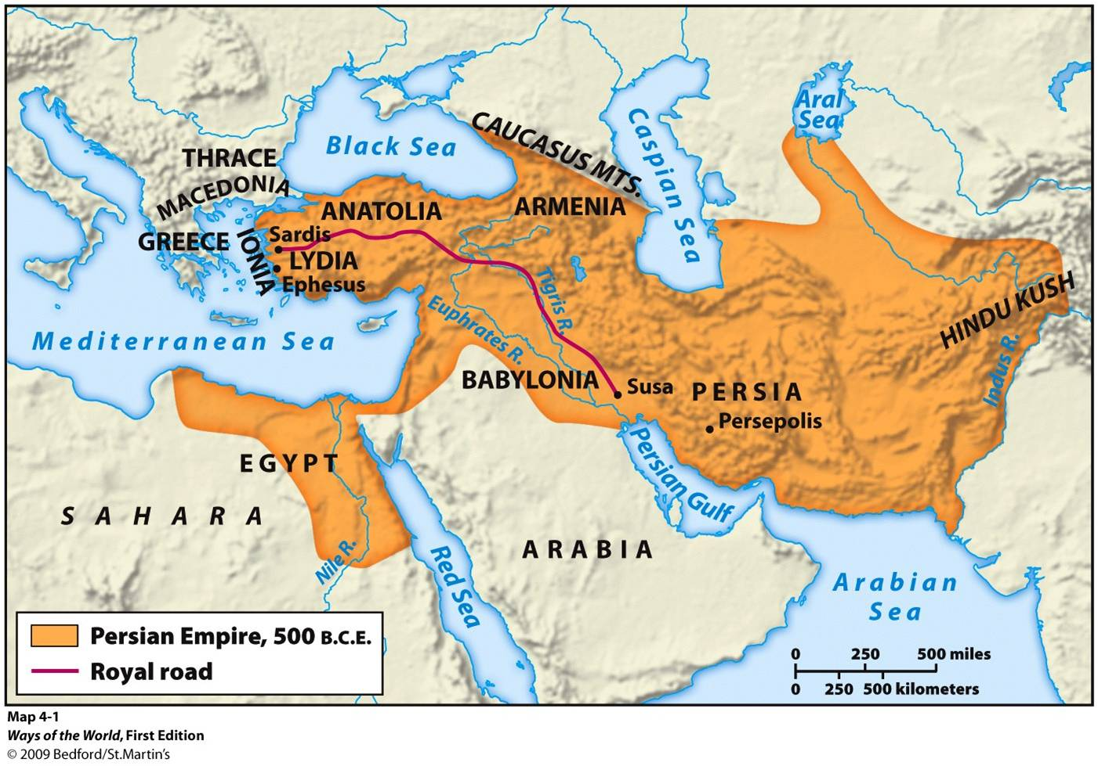
550 BC – 330 BC
Notes:
Freedom of religion – Persia 550- 330 BC
A vast empire greater than that of Babylon. Persian empire allowed them to return to Israel.

Slide 7
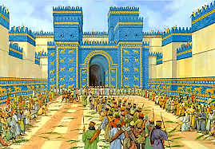
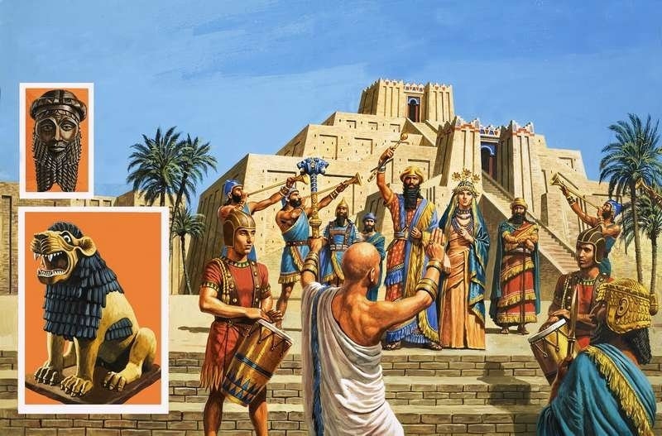
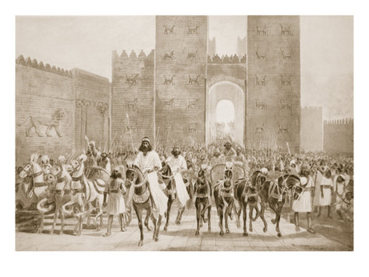
The Persian Empire
Notes:
the people cheered as Cyrus entered the city of Babylon knowing that they would have religious freedom

Slide 8
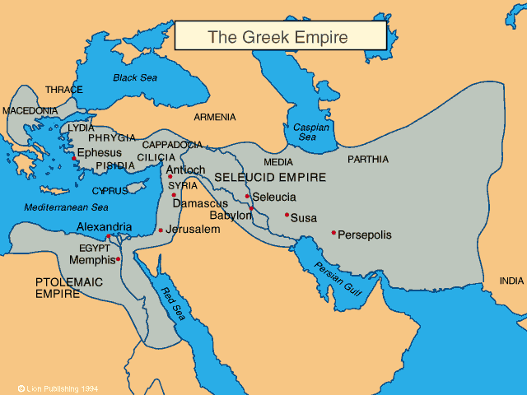
330 BC – 146 BC
Notes:
A written language common to all of the Mediterranean was needed for the NT story of Jesus

Slide 9
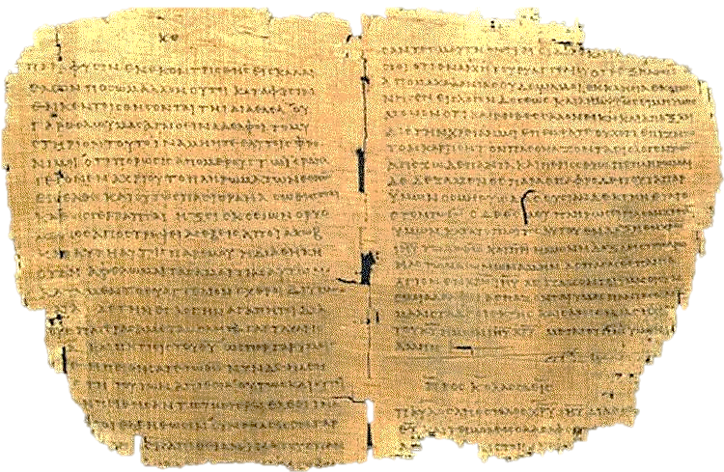
The Septuagint 200 BC
Notes:
The Septuagint from Alexandria before 200 BBC by 72 Jewish scholars;
This was the Greek translation Paul quoted.

Slide 10
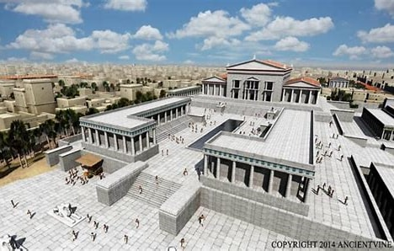
Notes:
Ptolemy II built the Alexandrian Library about 250 BC

Slide 11
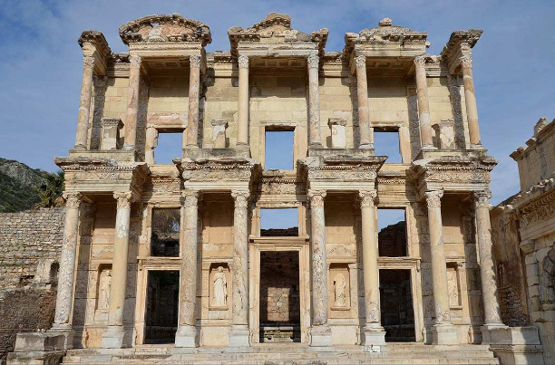
Notes:
Alexandrian Library today

Slide 12
146 BC – 476 AD west - 1453 AD east
Notes:
The Roman Empire provided roads and sea travel Without Borders

Slide 13
Roman Roads
Notes:
A picture of the Roman roads

Slide 14
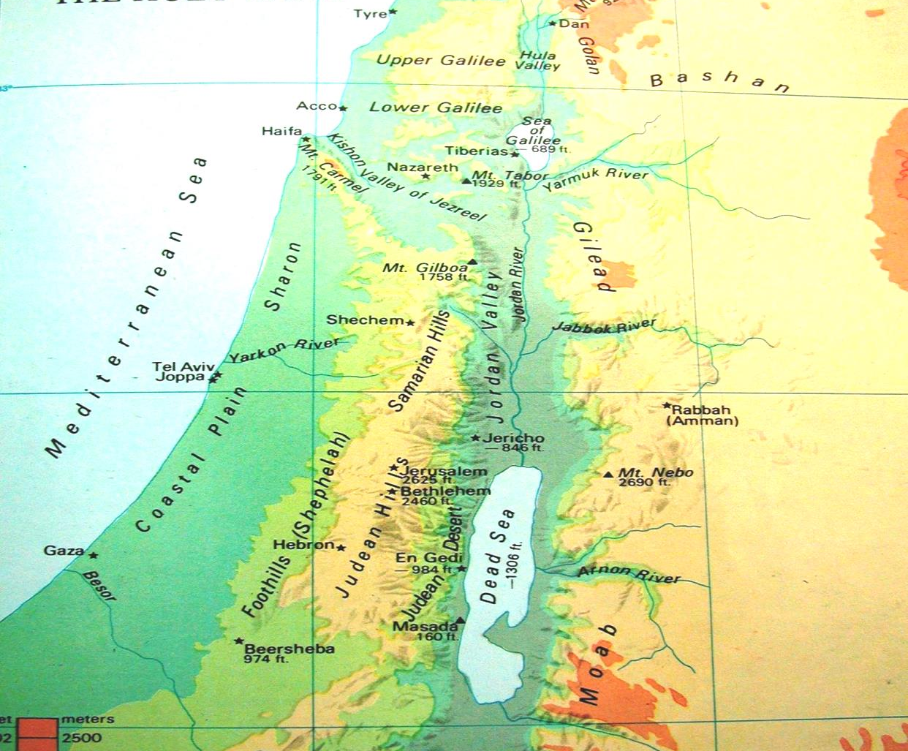
Notes:
This is the land where Jesus lived; top of picture

Slide 15
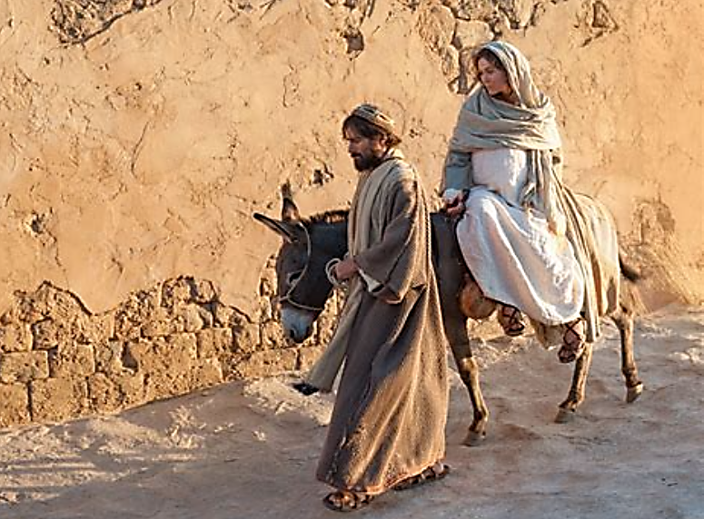

Slide 16
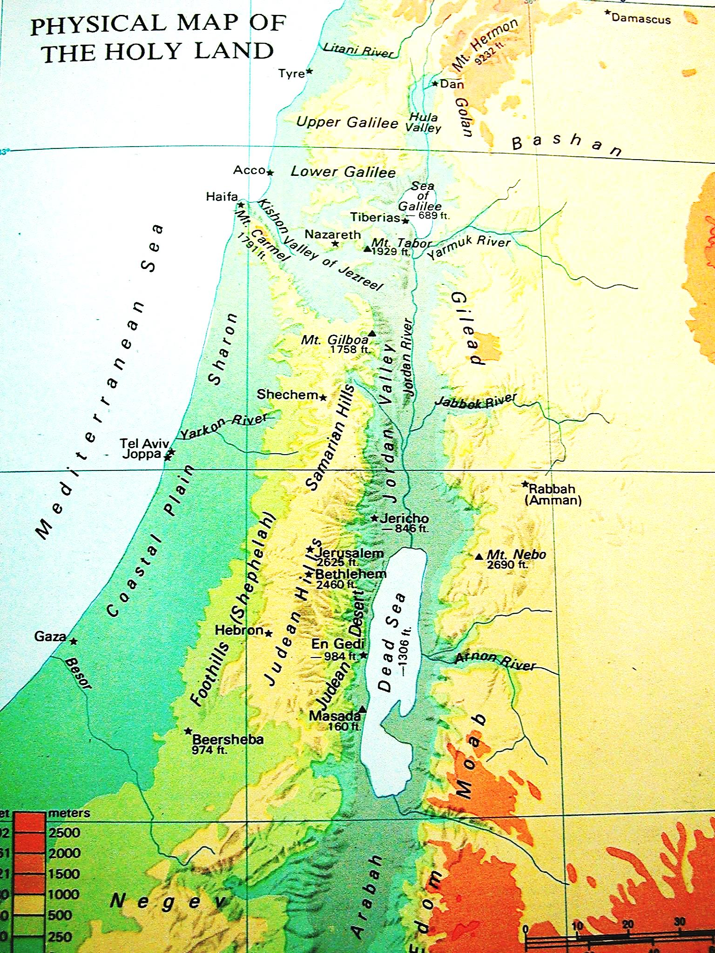
Notes:
Closer look next picture of the south
The arrow points toward his birthplace

Slide 17
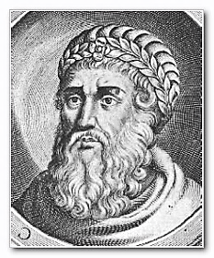
Herod The Great
Notes:
72 BC – 4 to 2 BC; Edomite; attacked Bethlehem; Jesus was born Before 3 BC;
Jesus was born about 4 BC

Slide 18
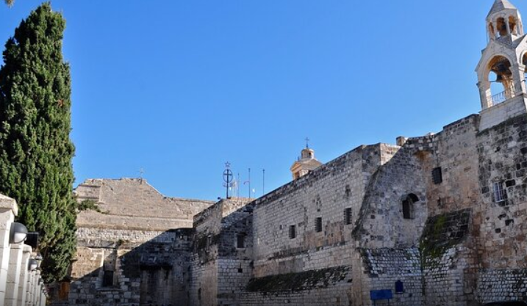
Micah 5:2
“But you, Bethlehem Ephrathah,
Though you are little among the thousands of Judah, Yet out of you shall come forth to Me
The One to be Ruler in Israel, Whose goings forth are from of old, From everlasting.”

Slide 19
“A voice was heard in Ramah,
Lamentation, weeping, and great mourning,
Rachel weeping for her children,
Refusing to be comforted,
Because they are no more.”
Mt 2:18 (Jer 31:15)
Notes:
at

Slide 22
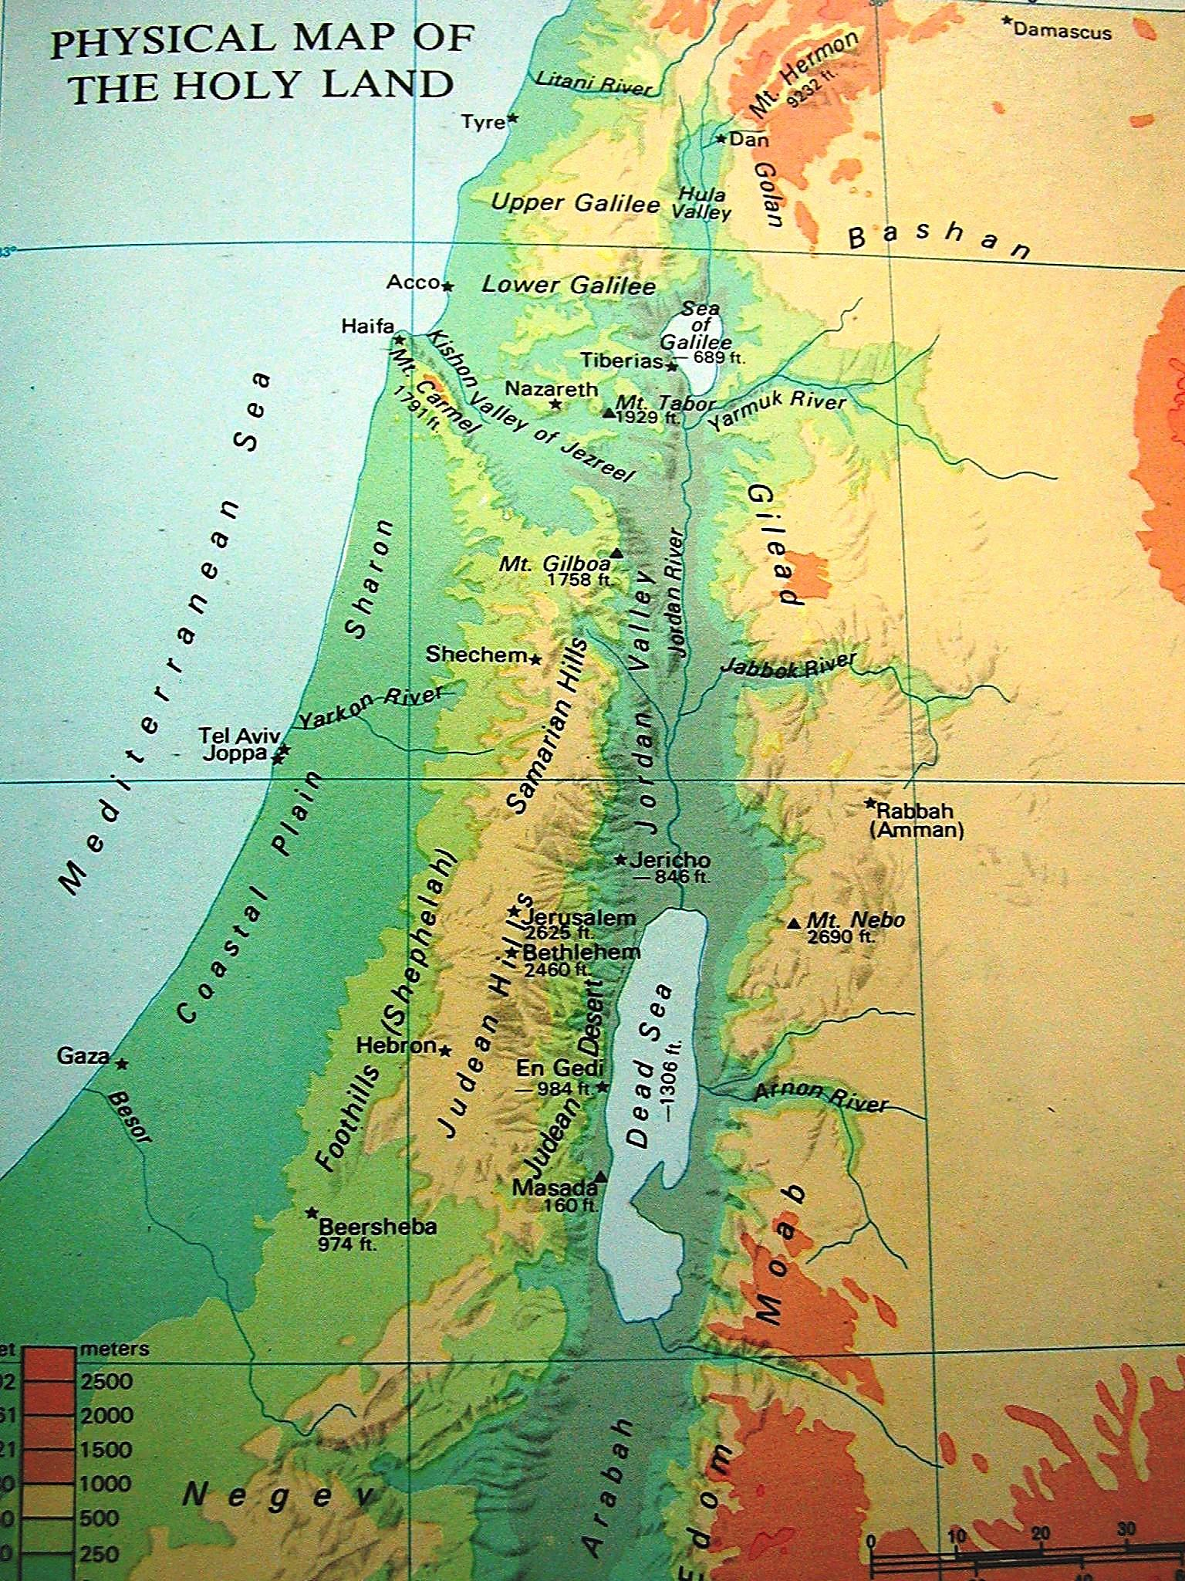

Slide 23
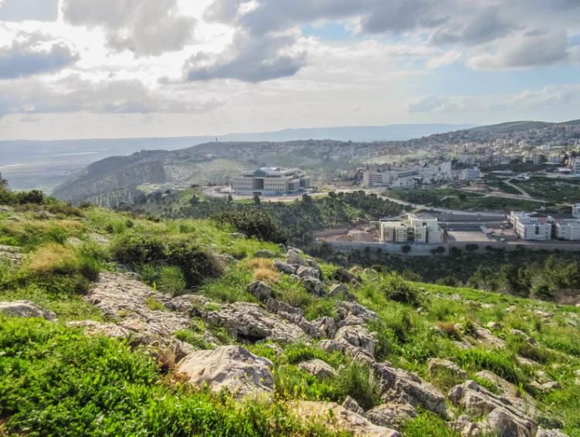
Notes:
Nathareth

Slide 24
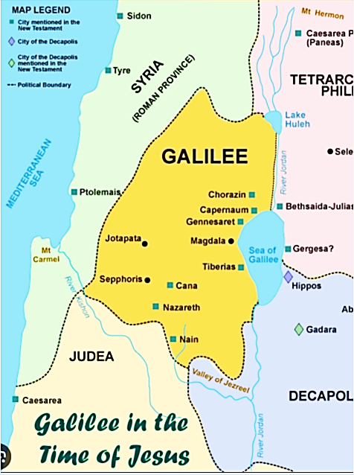

Slide 26
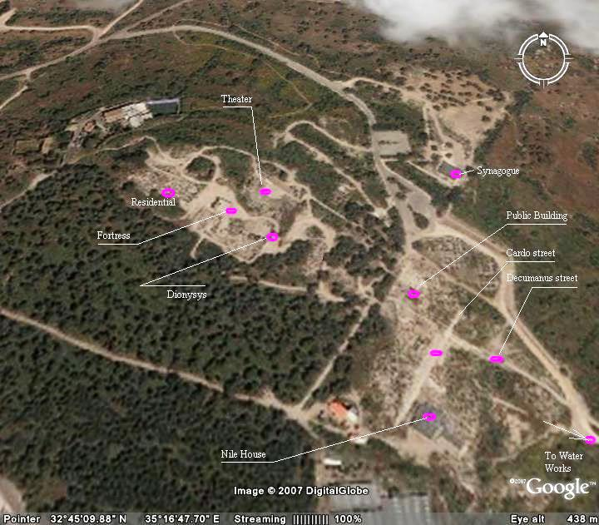
Sepphoris
Notes:
Sepphoris was a Henenistic city about 8 miles NE of Nazareth; “City on a hill cannot be hidden”

Slide 27
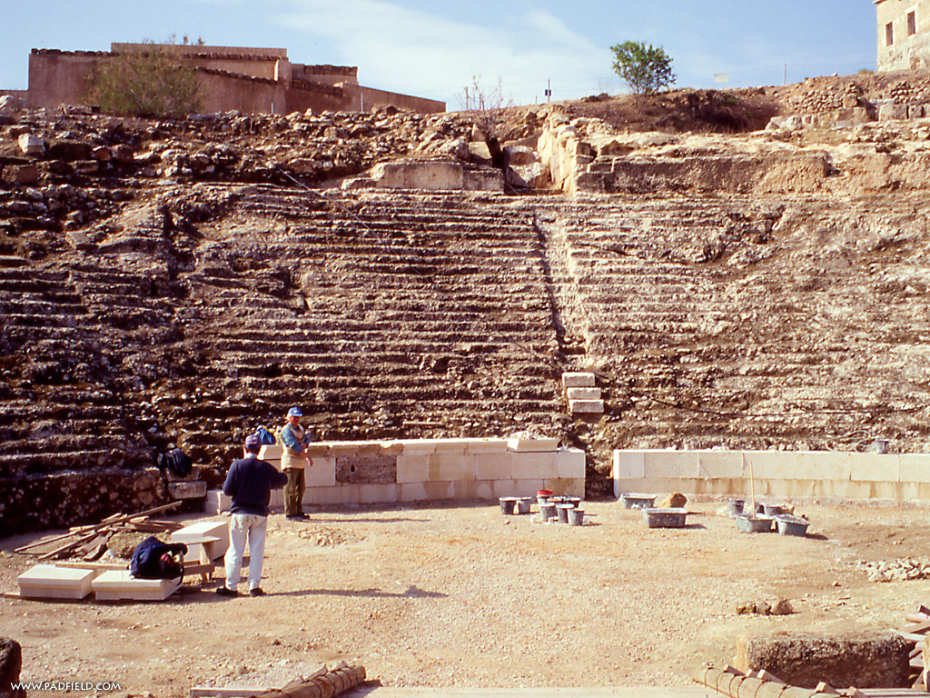
Sepphoris
Notes:
Sepphoris
Tradition – Birthplace of Mary
Close to Nazareth – possible Joseph did woodwork for them ???

Slide 28
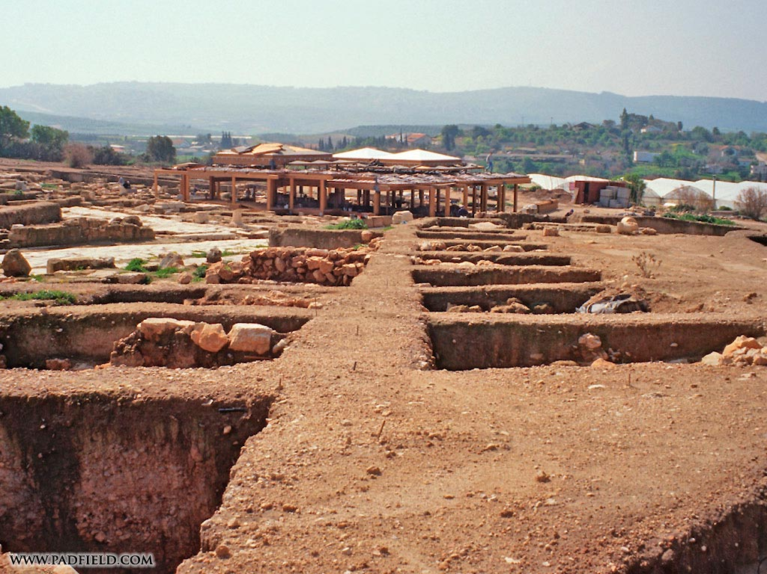
Notes:
Sepphoris

Slide 29
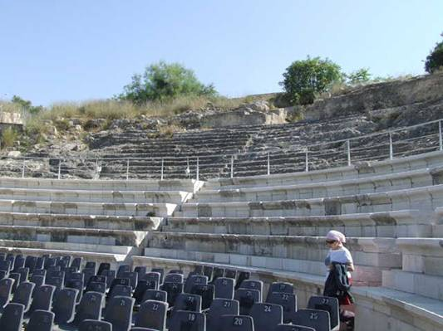
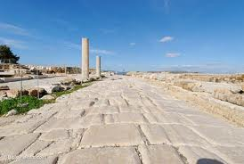
Notes:
Sepphoris

Slide 30
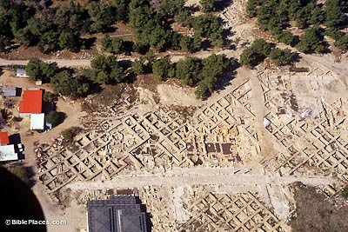
Notes:
Sepphoris

Slide 31
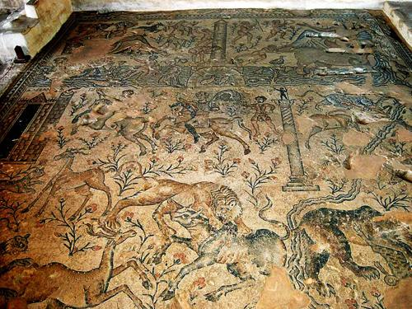
Notes:
Sepphoris

Slide 32
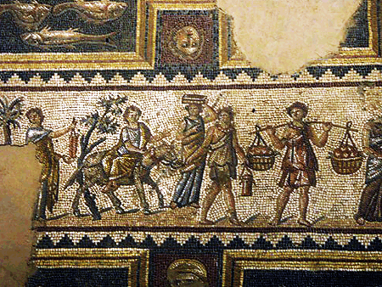
Notes:
Sepphoris

Slide 33
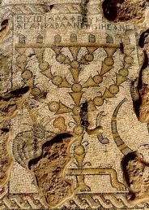
Notes:
Sepphoris - was who is she influence in the city

Slide 34
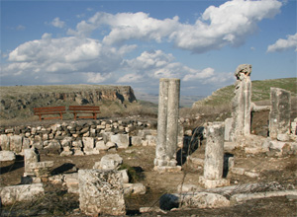
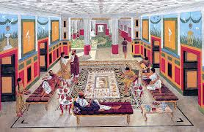
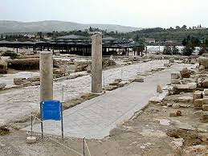
Notes:
Sepphoris

Slide 35
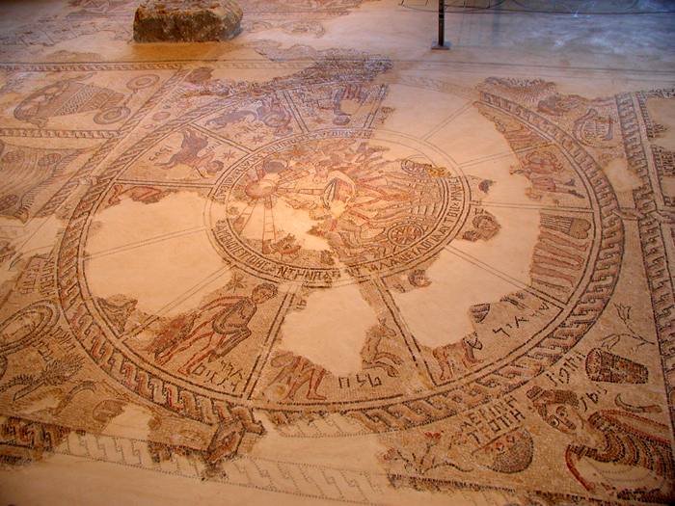
Notes:
Sepphoris

Slide 36
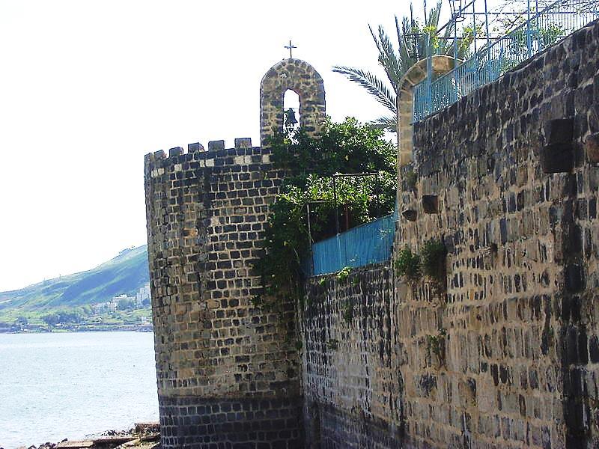
Notes:
Capernium - on the sea of Galilee, town of Peter, James and John

Slide 38
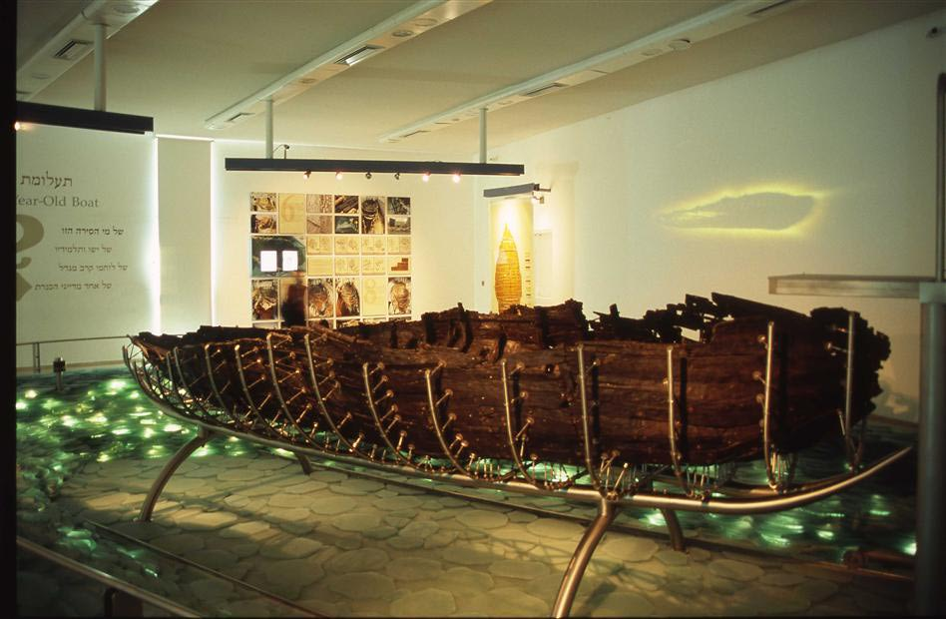
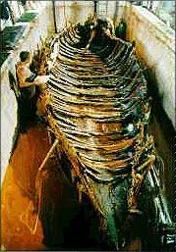
Notes:
Boat like disciples

Slide 39
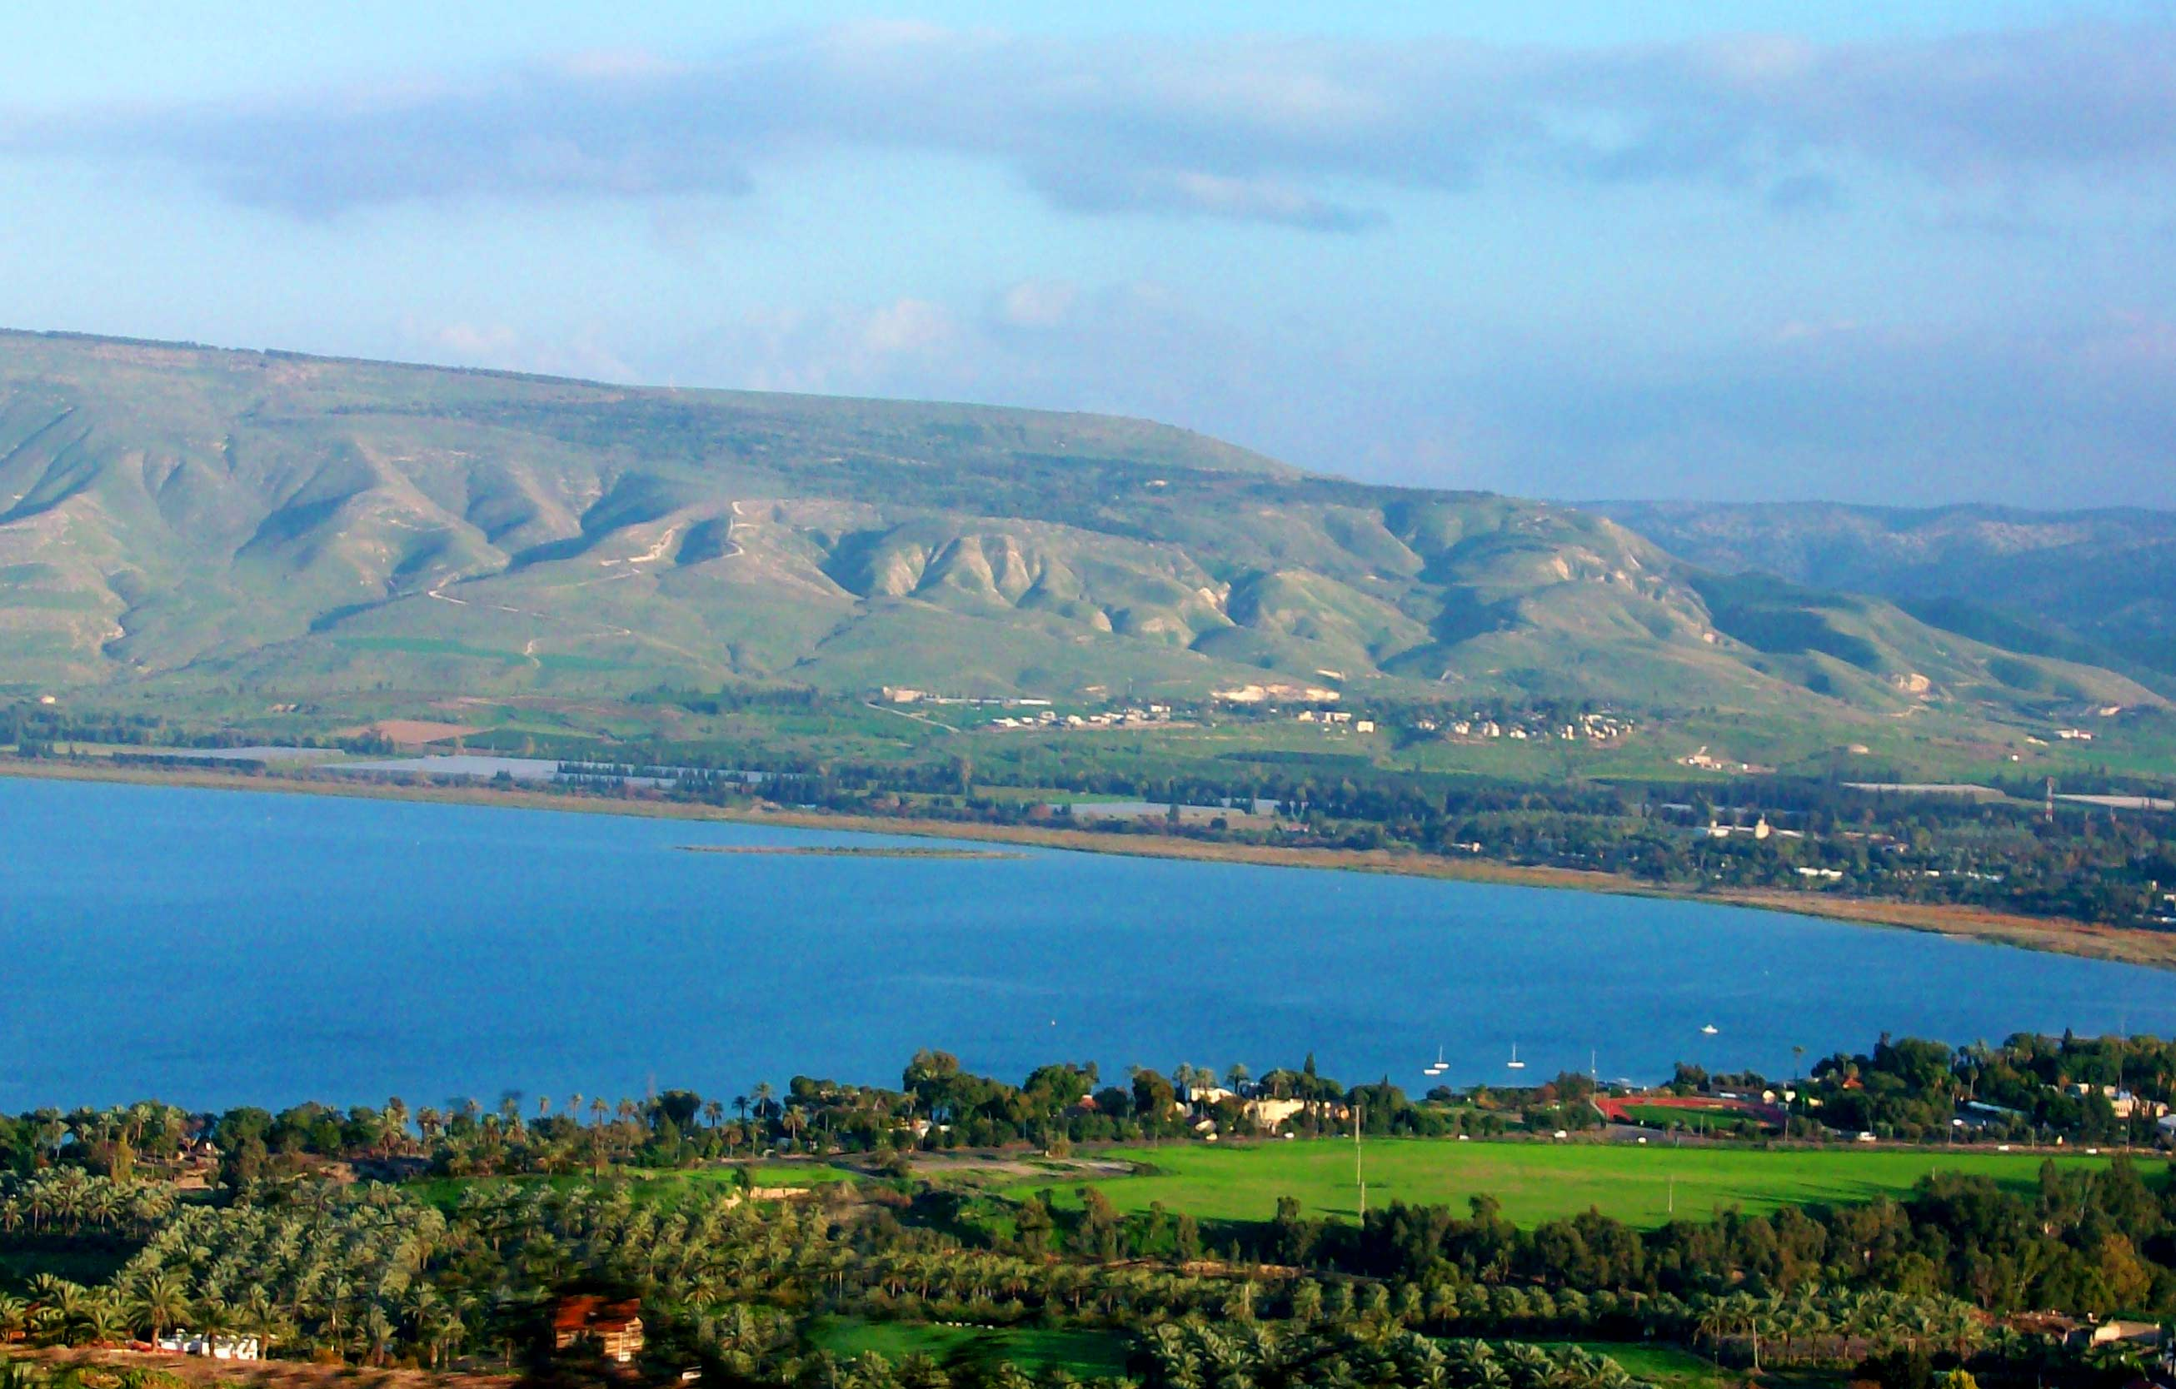
Notes:
Sea of Galilee – A Lake almost 700 feet below sea level

Slide 40
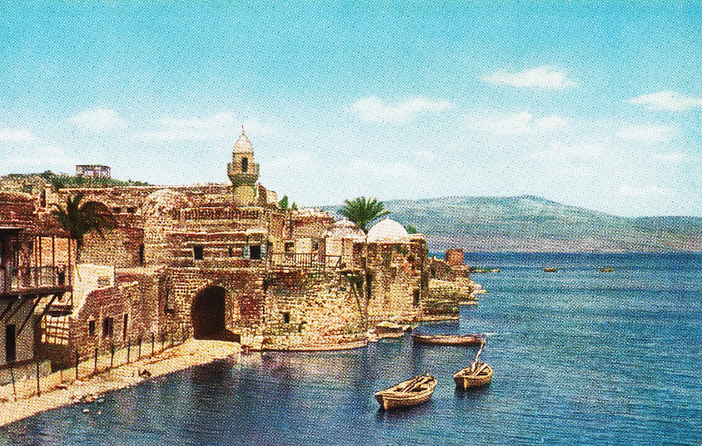
Notes:
Tiberias - also on the sea of Galilee,
After the resurrection Jesus revealed himself to the disciples here.

Slide 42
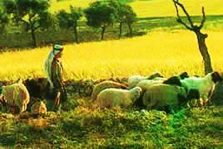
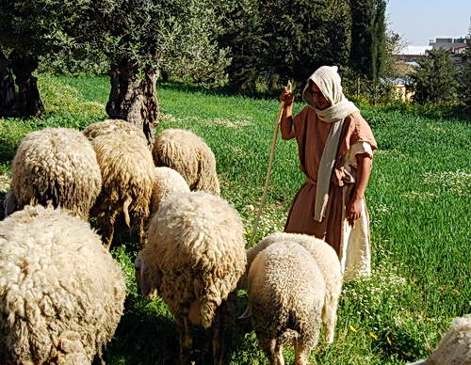
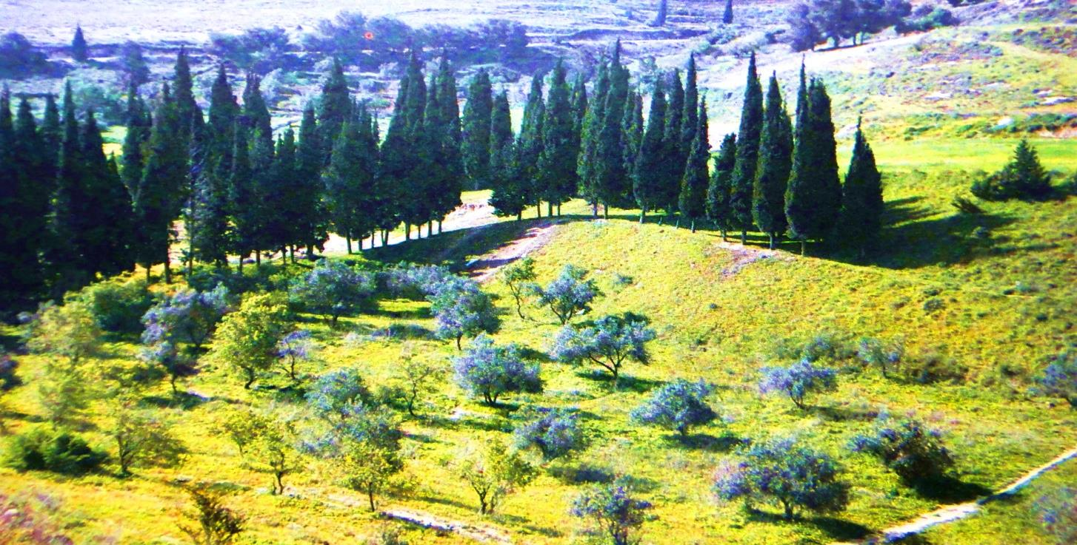
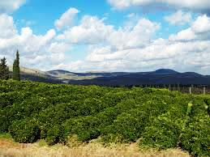
Notes:
Galilee a very lush valley; Jezreel ; Nazareth N, Meggedo S

Slide 43
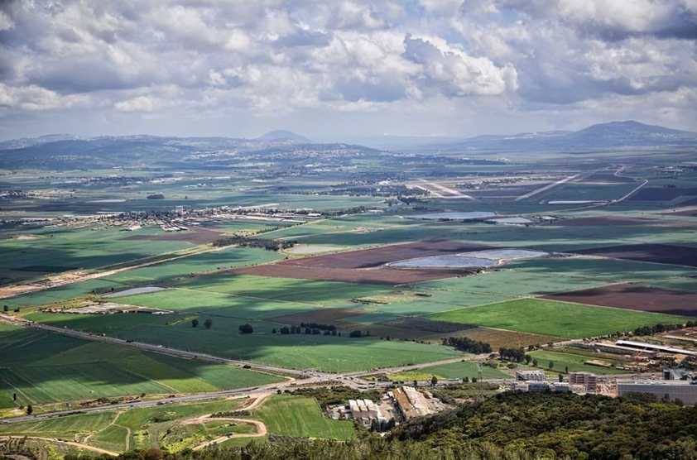
Notes:
Valley of Jezrael - Nazareth overlooked this valley

Slide 44
Luke 2:51
Then He went down with them and came to Nazareth, and was subject to them, but His mother kept all these things in her heart. ⁵²And Jesus increased in wisdom and stature, and in favor with God and men.

Slide 45
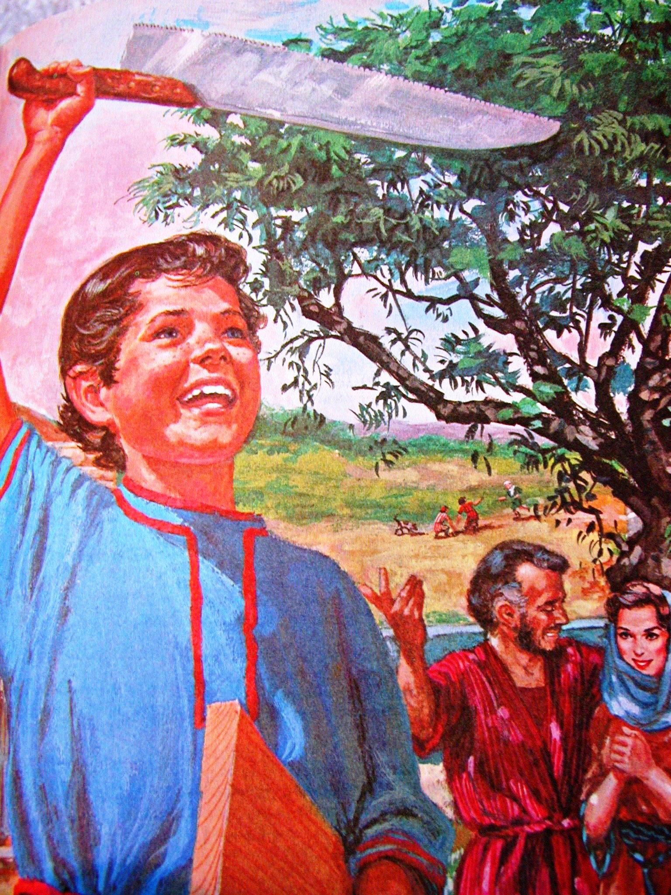
Notes:
Jesus lived in Nazareth until approximately 30 years of age

Slide 46
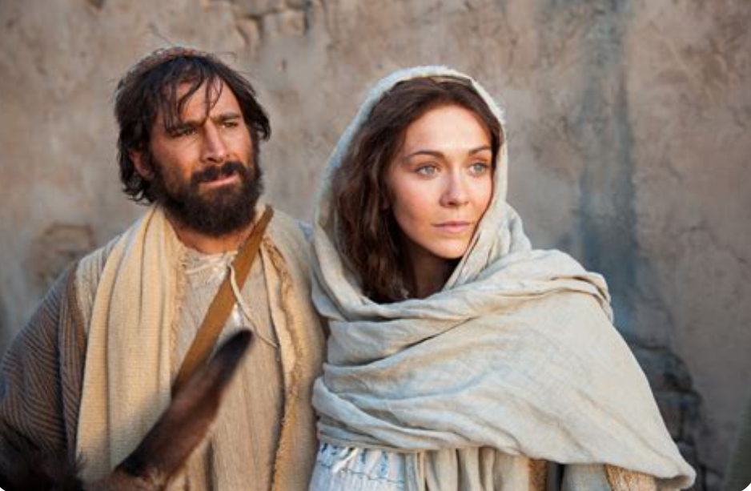
Notes:
Jesus had brothers – James, Joses, Simon, Judas + Sisters MT 13:55
?? Why did Jesus have John take care of Mary? His age?

Slide 47
Jesus – the Messiah in prophesy

Slide 48
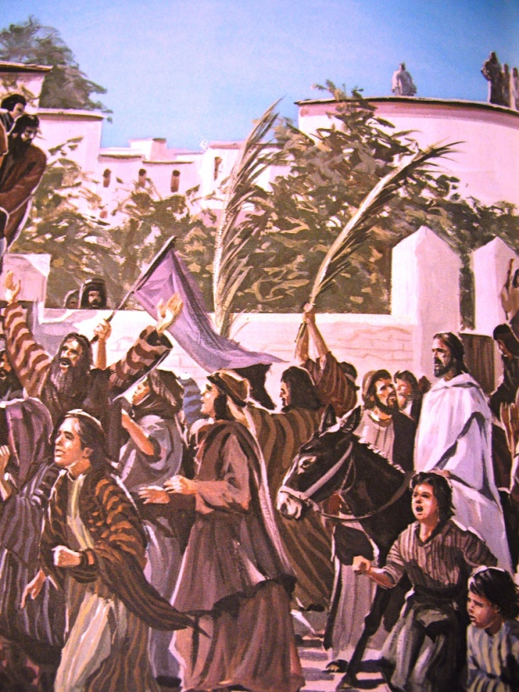
Shout, O daughter of Jerusalem!
Behold, your King is coming to you; He is just and having salvation, Lowly and riding on a donkey, A colt, the foal of a donkey.
Zach 9:9
Notes:
Several prophesies recognized by Jesus’ disciples after His death

Slide 49
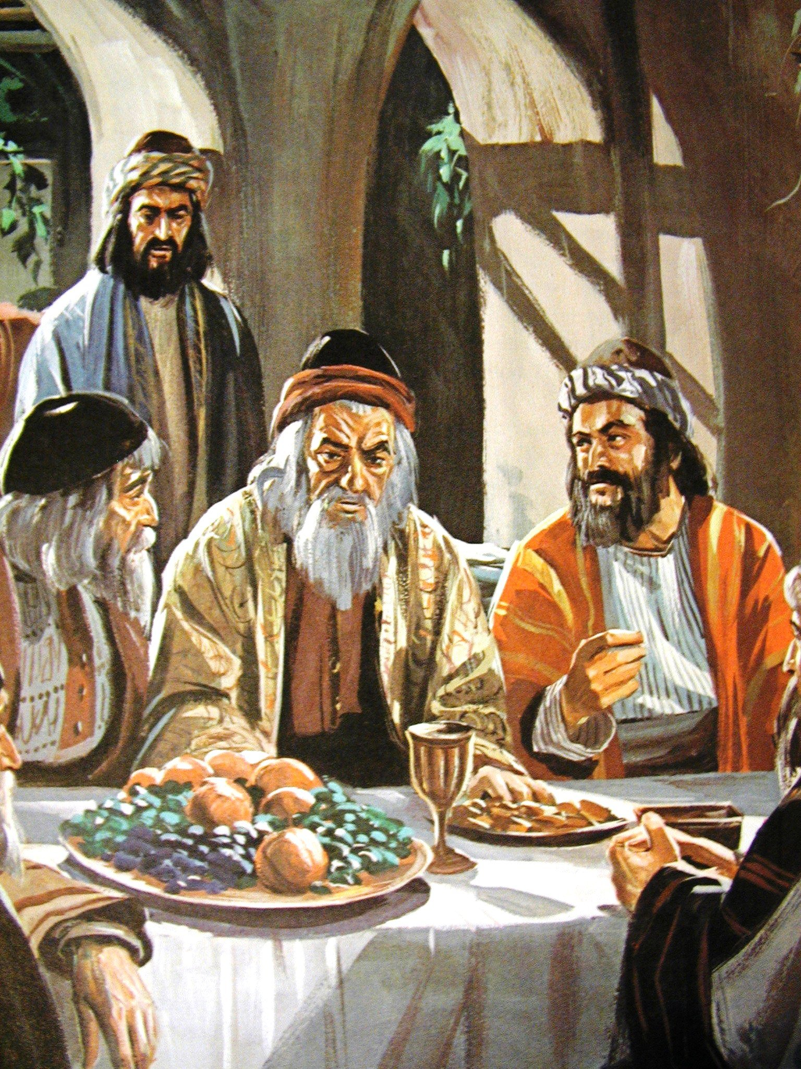
Then I said to them, “If it is agreeable to you, give me my wages; and if not, refrain.” So they weighed out for my wages thirty pieces of silver.
Zach 11:12

Slide 50
And the Lord said to me, “Throw it to the potter”—that princely price they set on me. So I took the thirty pieces of silver and threw them into the house of the Lord for the potter.
Zach 11:13

Slide 51
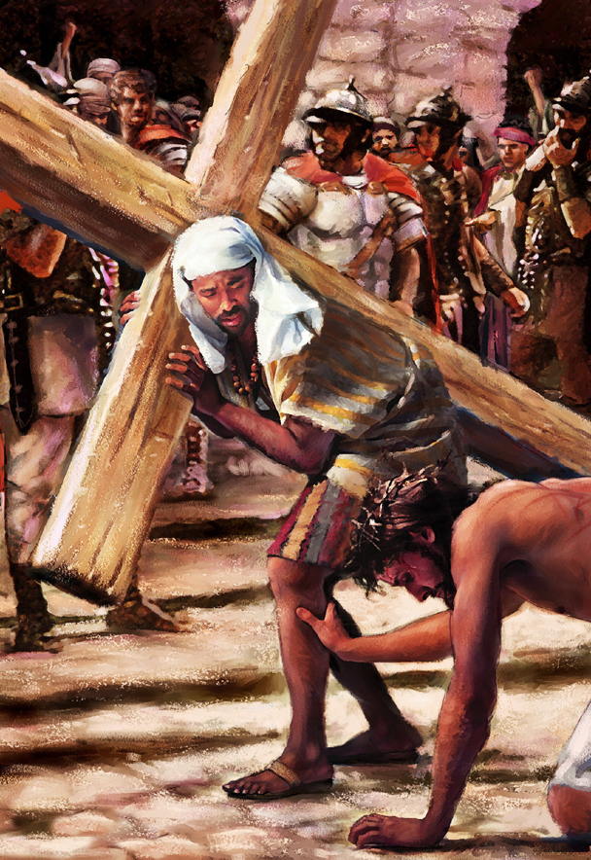
Isaiah 53
He was oppressed and He was afflicted, Yet He opened not His mouth; He was led as a lamb to the slaughter,
And as a sheep before its shearers is silent, So He opened not His mouth.

Slide 52
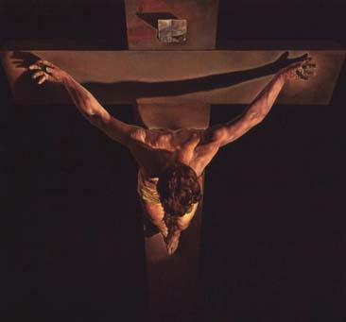
He guards all his bones;
Not one of them is broken.
Psalms 34:20

Slide 53
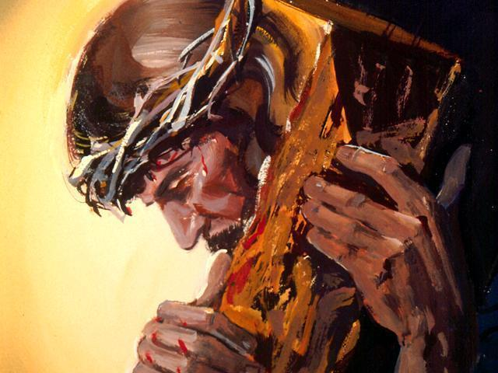
Isaiah 53:5
But He was wounded for our transgressions, He was bruised for our iniquities; The chastisement for our peace was upon Him, And by His stripes we are healed.

Slide 54
Isaiah 53:6
All we like sheep have gone astray; We have turned, every one, to his own way; And the Lord has laid on Him the iniquity of us all.

Slide 55
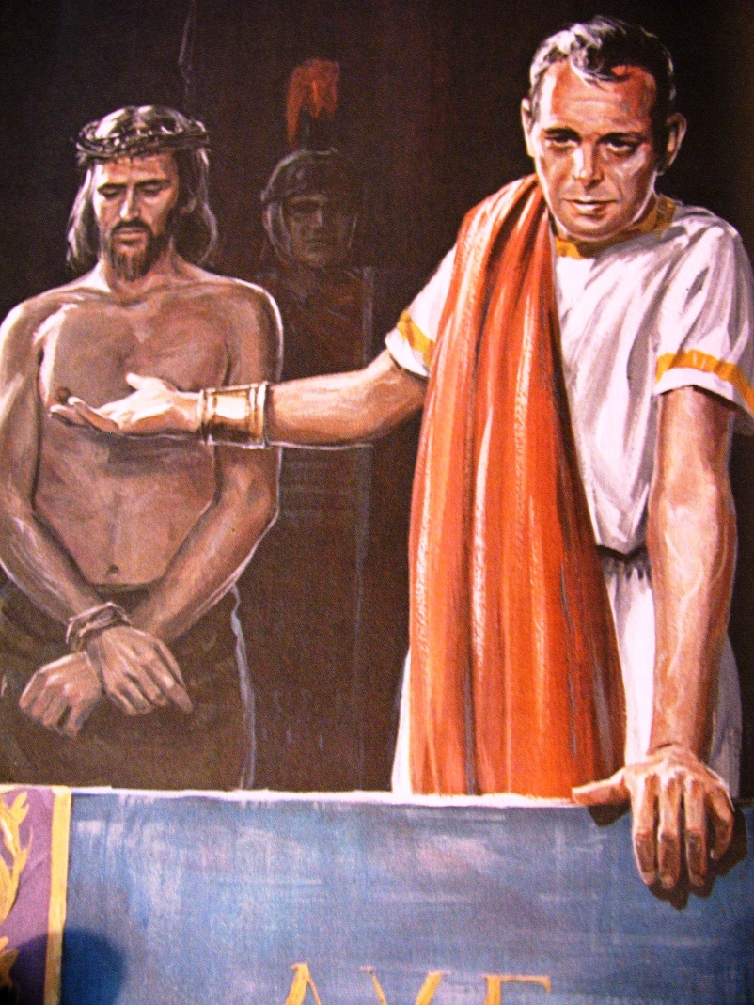
He was taken from prison and from judgment, And who will declare His generation? For He was cut off from the land of the living;
For the transgressions of My people He was stricken.
Isaiah 53:8

Slide 56
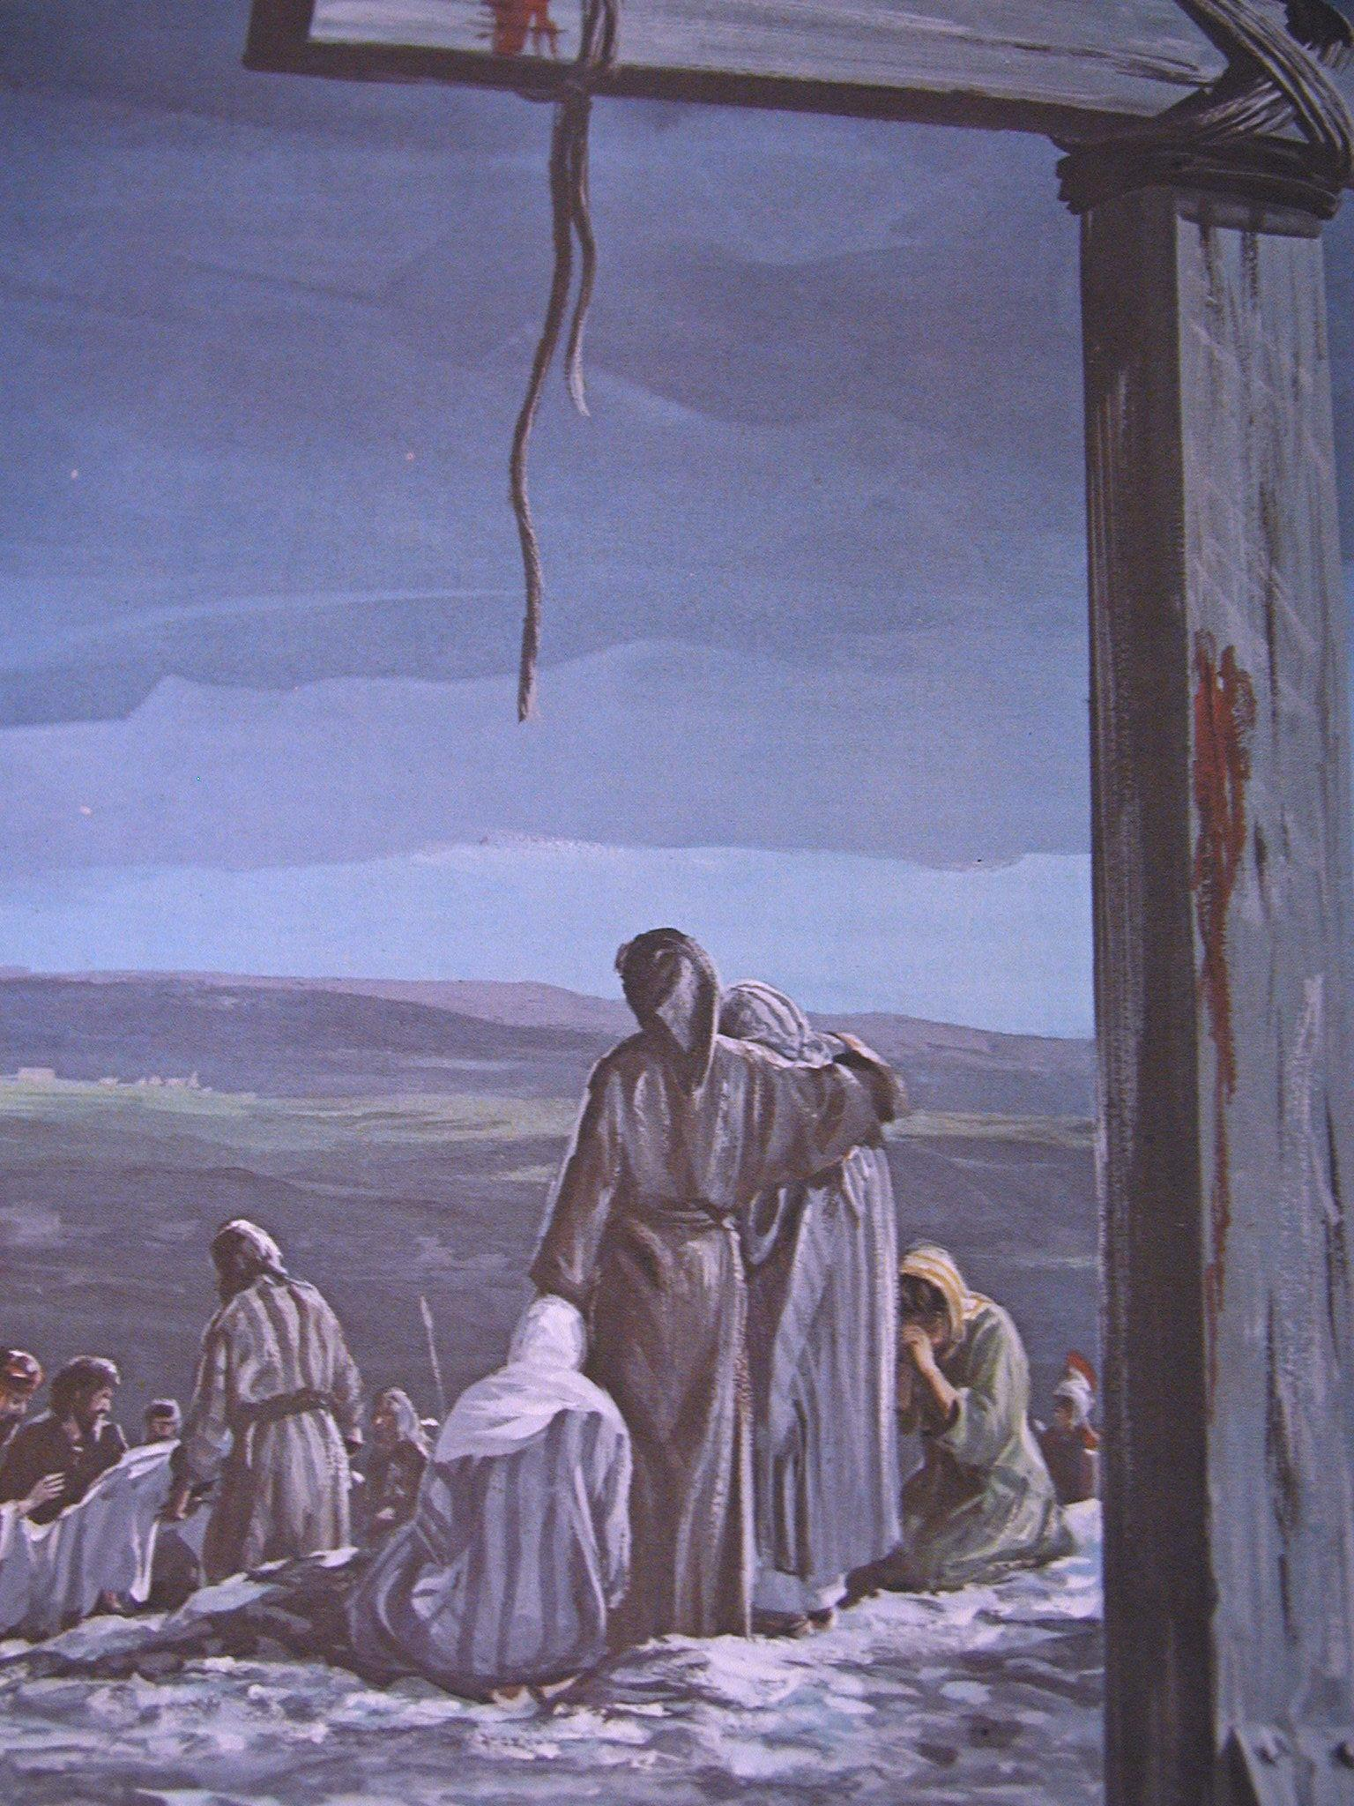
And they made His grave with the wicked— But with the rich at His death, Because He had done no violence, Nor was any deceit in His mouth.
Isaiah 53:9

Slide 57
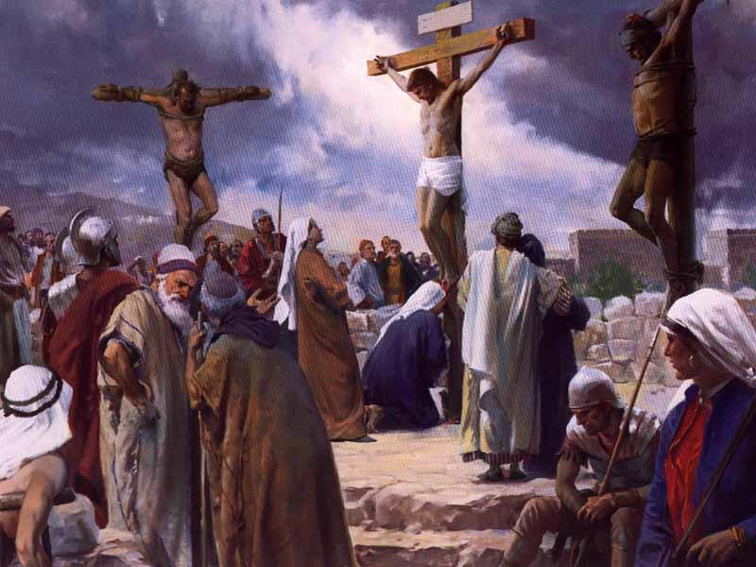
For dogs have surrounded Me; The congregation of the wicked has enclosed Me. They pierced My hands and My feet; I can count all My bones. They look and stare at Me.
Ps 22:16-17

Slide 58
Ps 22:16-17
They divide My garments among them, And for My clothing they cast lots.

Slide 59
My God, My God, why have You forsaken Me?
Ps 22:1

Slide 60
Then he shall confirm a covenant with many for one week; But in the middle of the week He shall bring an end to sacrifice and offering.
Dan 9:27

Slide 61
“Greater love has no one than this, than to lay down one’s life for his friends.”
John 15:13

Slide 62
Judas - Suicide - Jerusalem
James - Sword - Judea
Peter - Crucified - Rome
Paul - Beheaded - Rome
Andrew - Crucified - Russia
Thomas - Spear - India
Philip - Tortured - Carthage
Mathew -Stabbed - - Ethiopia
Bartholomew - killed - Arabia
James - Stoned, Clubbed- Syria
Simon - killed - Persia
Matthias - Burned - Syria
John – Ephesus - Old Age

Slide 63
Notes:
They witnessed His resurrection

Slide 64
Notes:
They believed in HIS promise to return. Do you believe it enough to change your life? Change the way you spend your time?

