Slide 1
Favorite

Slide 2
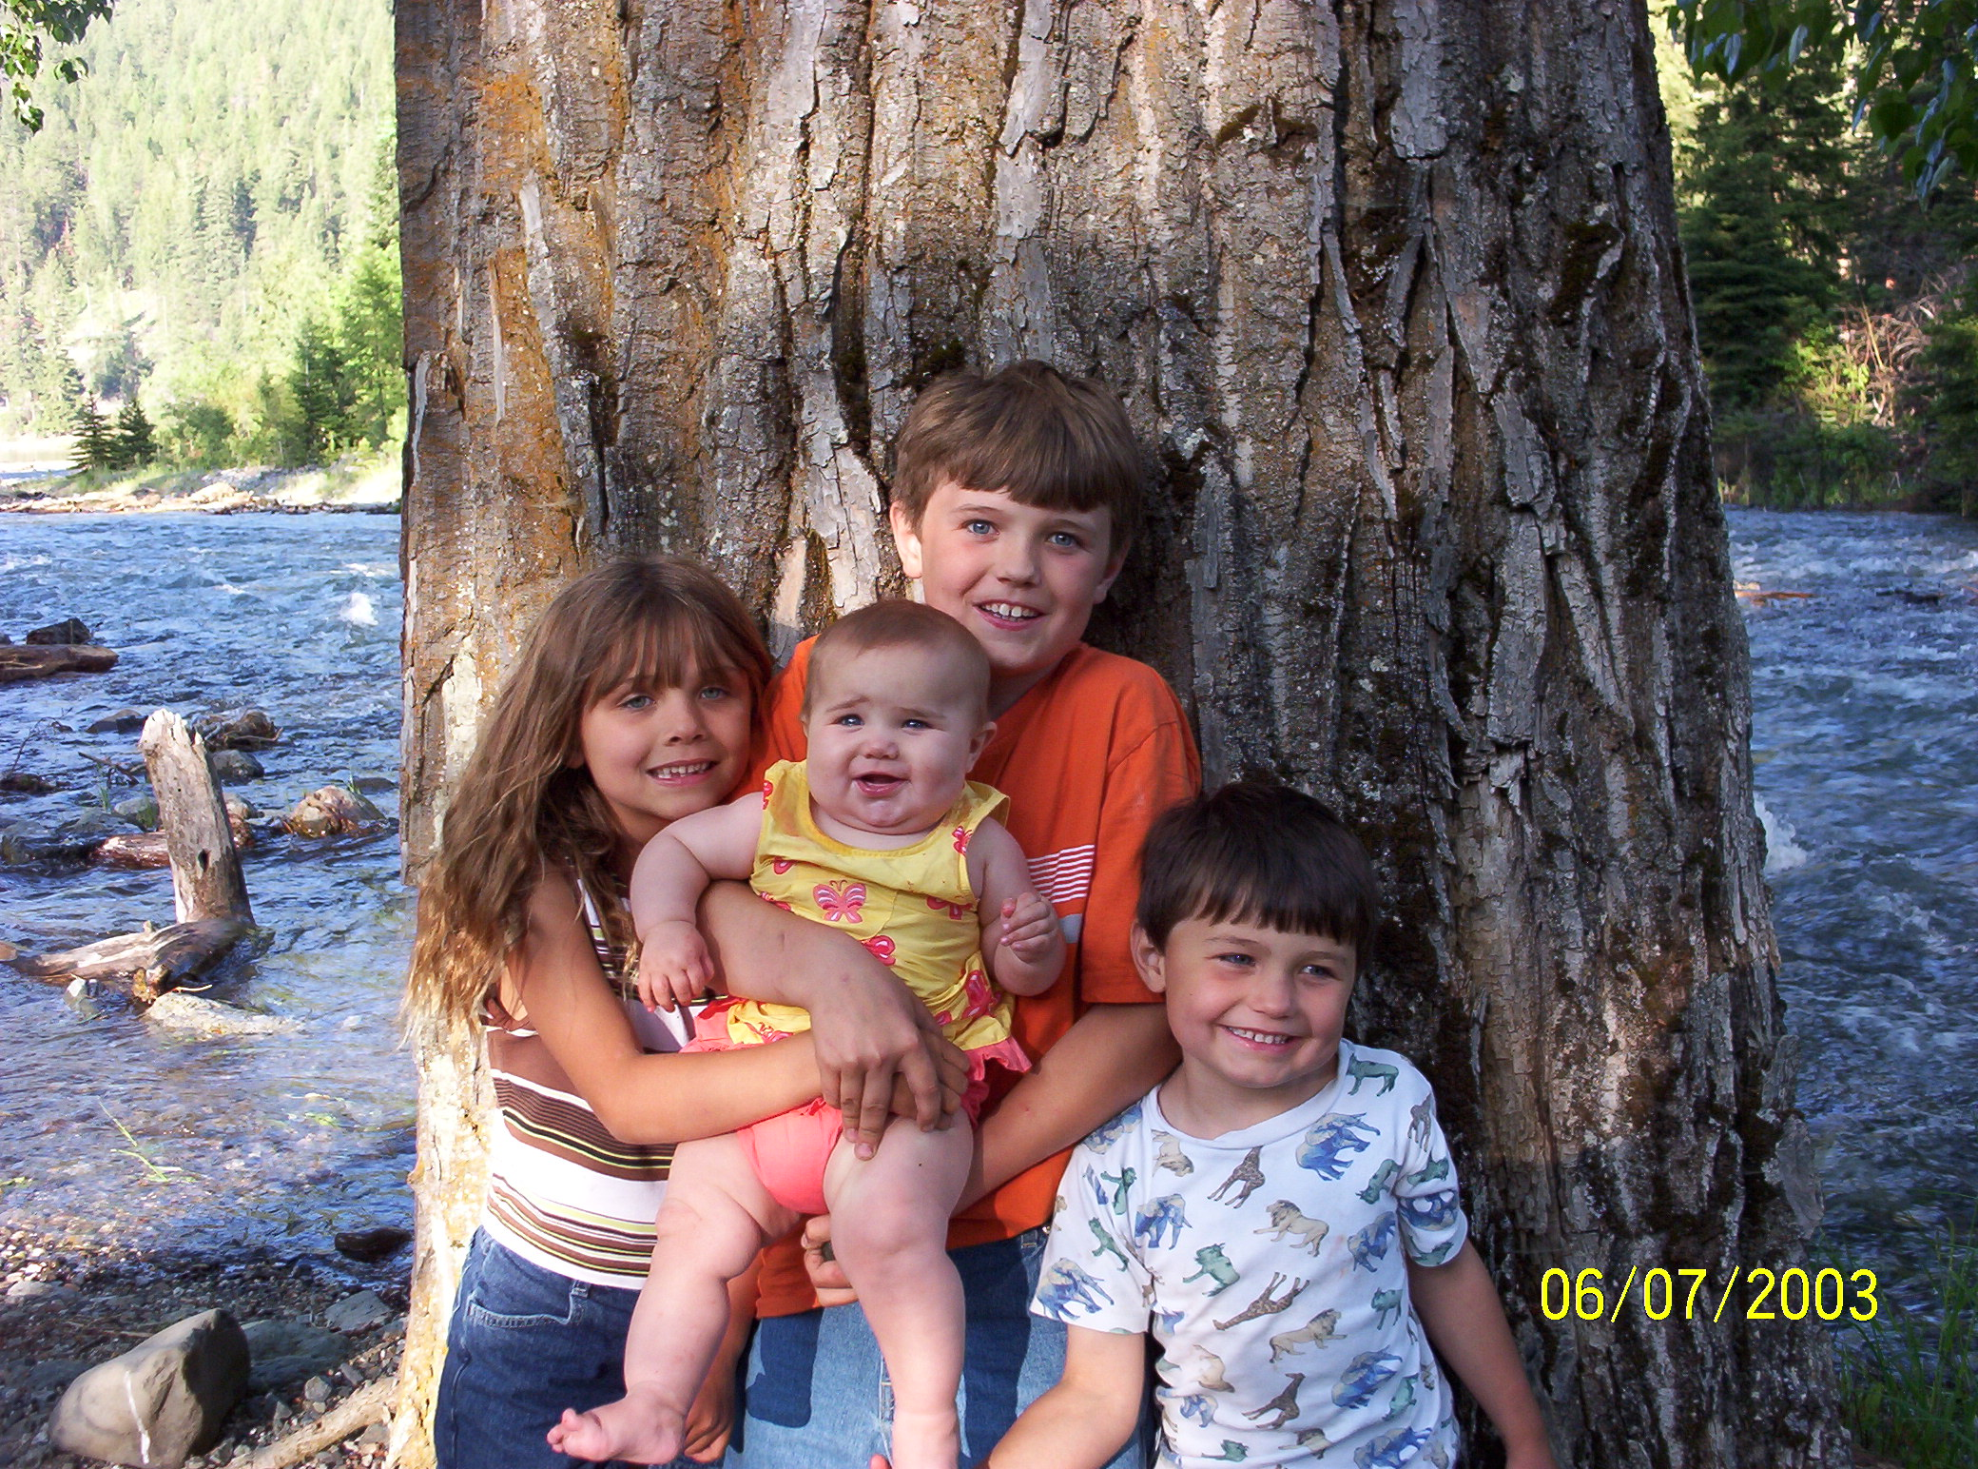

Slide 4
You whom I have taken from the ends of the earth, And called from its farthest regions, And said to you, ‘You are My servant, I have chosen you and have not cast you away: Fear not, for I am with you; Be not dismayed, for I am your God. I will strengthen you, Yes, I will help you, I will uphold you with My righteous right hand
Isaiah 41:9-10

Slide 6
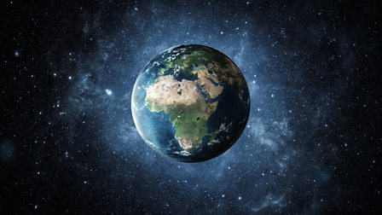

Slide 7
You whom I have taken from the ends of the earth, And called from its farthest regions, And said to you, ‘You are My servant, I have chosen you and have not cast you away: Fear not, for I am with you; Be not dismayed, for I am your God. I will strengthen you, Yes, I will help you, I will uphold you with My righteous right hand
Isaiah 41:9-10

Slide 8
Definition of a servant #1
One who serves others, a person who performs duties for others especially a person employed in the house of domestic duties. Or as a personal attendant.

Slide 9
You whom I have taken from the ends of the earth, And called from its farthest regions, And said to you, ‘You are My servant, I have chosen you and have not cast you away:
Isaiah 41:9

Slide 10
Definition of a servant #2
A devoted helpful follower or supporter.

Slide 11
Everyone who accepts Christ as a personal savior will long for the privilege of serving God. Contemplating what heaven has done for him, his heart is moved with boundless love and adoring gratitude. He is eager to signalize his gratitude by devoting his abilities to Gods service. He longs to show his love for Christ and for His purchased possession.
Ministry of healing page 502

Slide 12
Definition of a servant #3
One who voluntarily choses to serve another, not a slave.

Slide 13
You whom I have taken from the ends of the earth, And called from its farthest regions, And said to you, ‘You are My servant, I have chosen you and have not cast you away:
Isaiah 41:9

Slide 15
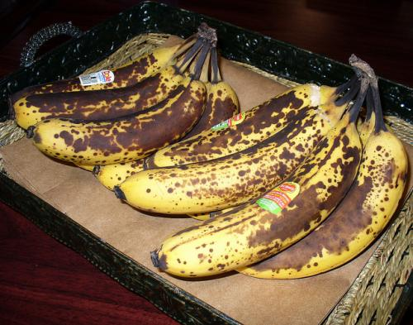

Slide 16
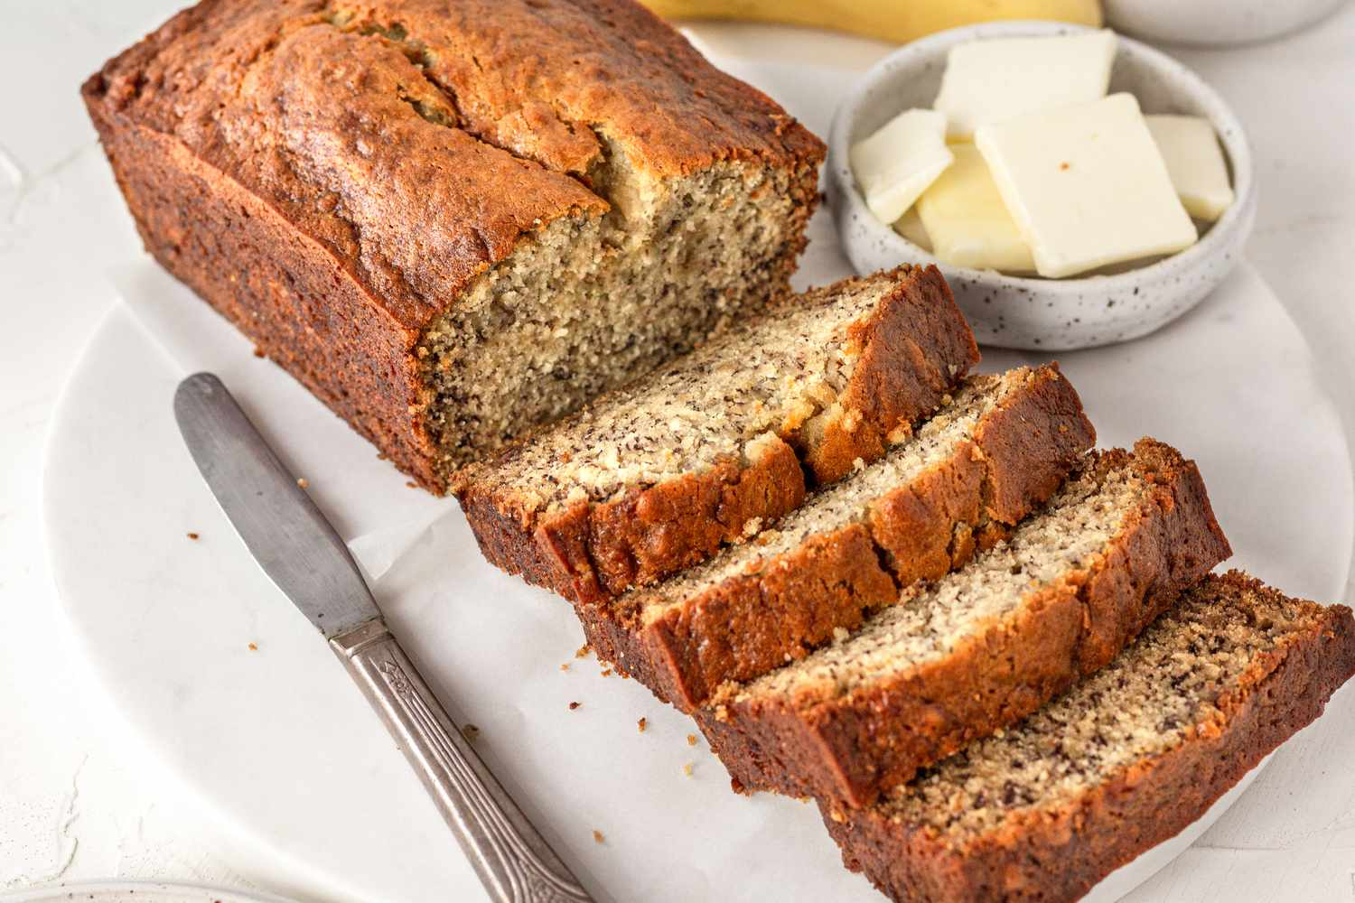

Slide 19
You whom I have taken from the ends of the earth, And called from its farthest regions, And said to you, ‘You are My servant, I have chosen you and have not cast you away:
Isaiah 41:9

Slide 22
Therefore, if anyone is in Christ, he is a new creation; old things have passed away; behold, all things have become new.
2 Corinthians 5:17

Slide 23
Fear not, for I am with you; Be not dismayed, for I am your God. I will strengthen you, Yes, I will help you, I will uphold you with My righteous right hand
Isaiah 41:10

Slide 25
Verses that say do not fear
Psalm 23:4 Yea, though I walk through the valley of the shadow of death, I will fear no evil: for thou art with me; thy rod and thy staff they comfort me.
Joshua 1:9 Be strong and of a good courage, be not afraid for the Lord your God is with you, wherever you go.
Lamentations 3:57 You came near when I called you, and you said, “Do not fear.”
Hebrews 13:6 So we say with confidence, “The Lord is my helper; I will not be afraid. What can mere mortals do to me?”
John 14:27 Peace I leave with you; my peace I give you. I do not give to you as the world gives. Do not let your hearts be troubled and do not be afraid.
Revelation 1:17 When I saw him, I fell at his feet as though dead. Then he placed his right hand on me and said: “Do not be afraid. I am the First and the Last.

Slide 26
Be strong and of good courage, do not fear nor be afraid of them; for the Lord your God, He is the One who goes with you. He will not leave you nor forsake you.”
Deuteronomy 31:6
But the very hairs of your head are all numbered. Do not fear therefore; you are of more value than many sparrows.
Luke 12:7

Slide 27
Do not be anxious about anything, but in every situation, by prayer and petition, with thanksgiving, present your requests to God. 7 And the peace of God, which transcends all understanding, will guard your hearts and your minds in Christ Jesus.
Philippians 4:6-7

Slide 28
Fear not, for I am with you; Be not dismayed, for I am your God. I will strengthen you, Yes, I will help you, I will uphold you with My righteous right hand
Isaiah 41:10

Slide 31
Texts that strengthen me
Exodus 15:2 “The Lord is my strength and my defense; he has become my salvation…”
Nehemiah 8:10 “... Do not sorrow, for the joy of the Lord is your strength.”
Psalms 46:1 God is our refuge and strength, very present help in trouble.
Psalms 119:28 My soul is weary with sorrow; strengthen me according to your word.

Slide 32
Fear not, for I am with you; Be not dismayed, for I am your God. I will strengthen you, Yes, I will help you, I will uphold you with My righteous right hand
Isaiah 41:10

Slide 33
he wants to help you
No temptation has overtaken you except what is common to mankind. And God is faithful; he will not let you be tempted beyond what you can bear. But when you are tempted, he will also provide a way out so that you can endure it.
1 Corinthians 10:13

Slide 34
He wants you to forgive
Bear with each other and forgive one another if any of you has a grievance against someone. Forgive as the Lord forgave you.
Colossians 3:13

Slide 35
He want to give you peace
Peace I leave with you; my peace I give you. I do not give to you as the world gives. Do not let your hearts be troubled and do not be afraid.
John 14:27

Slide 36
He wants you to grow closer to HIm
Come near to God and he will come near to you. Wash your hands, you sinners, and purify your hearts, you double-minded.
James 4:8

Slide 37
He wants To give you rest
“Come to me, all you who are weary and burdened, and I will give you rest.”
Matthew 11:28

Slide 38
Fear not, for I am with you; Be not dismayed, for I am your God. I will strengthen you, Yes, I will help you, I will uphold you with My righteous right hand
Isaiah 41:10

Slide 39
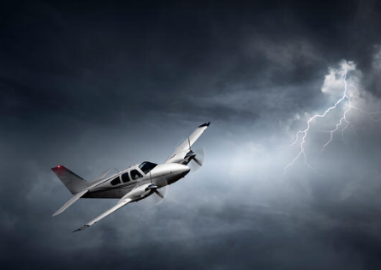

Slide 40
Fear not, for I am with you; Be not dismayed, for I am your God. I will strengthen you, Yes, I will help you, I will uphold you with My righteous right hand
Isaiah 41:10

Slide 41
For I am persuaded that neither death nor life, nor angels nor principalities nor powers, nor things present nor things to come, 39 nor height nor depth, nor any other created thing, shall be able to separate us from the love of God which is in Christ Jesus our Lord.
Romans 8:38-39

