Slide 1
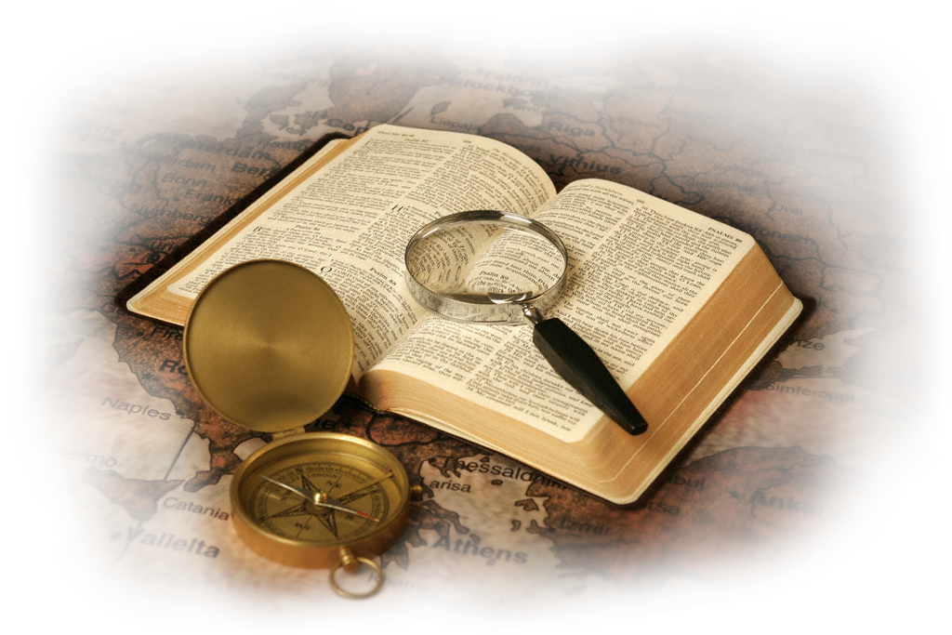

Slide 2
With today’s changing and polarizing societal movements and ideologies such as pro-choice vs. pro-life, LGBTQ+, the ever-expanding definitions of gender identification, women’s “Me Too” rights, Black Lives Matter, racial unease, political divides (Republican v. Democrat; Liberal v. Conservative; Right v. Left), economic uncertainty, border insecurity, climate fears, pandemic hysteria, and a growing list of nations in turmoil or at war…
What’s a Christian to Do In this Culture?

Slide 3
Acts 18:1-5
1 Corinthians 2:1-5
Christ’s Cross Confronts Our Culture at Corinth’s Crossroads
Paul’s strategy for evangelism #2

Slide 4
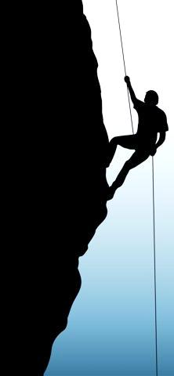
Why study Acts 18?
“The whole book of Acts should receive careful study. It is full of precious instruction; it records experiences in evangelistic work, the teachings of which we need in our work today. This is a wonderful history; it deals with the highest education…”
(Ellen White, 7-A BC, page 275)

Slide 5
Acts 18:1
1 After these things [Paul] left Athens and went to Corinth…
Athens to Corinth:
52 miles by land
44 miles as crow flies

Slide 6
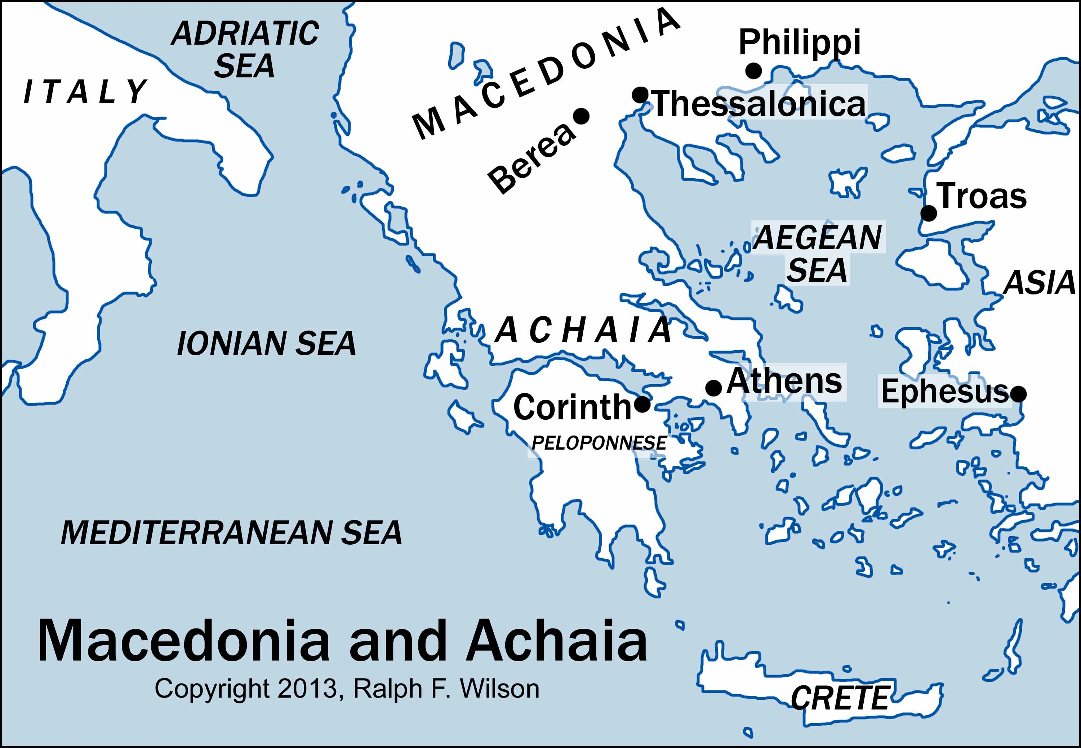

Slide 7
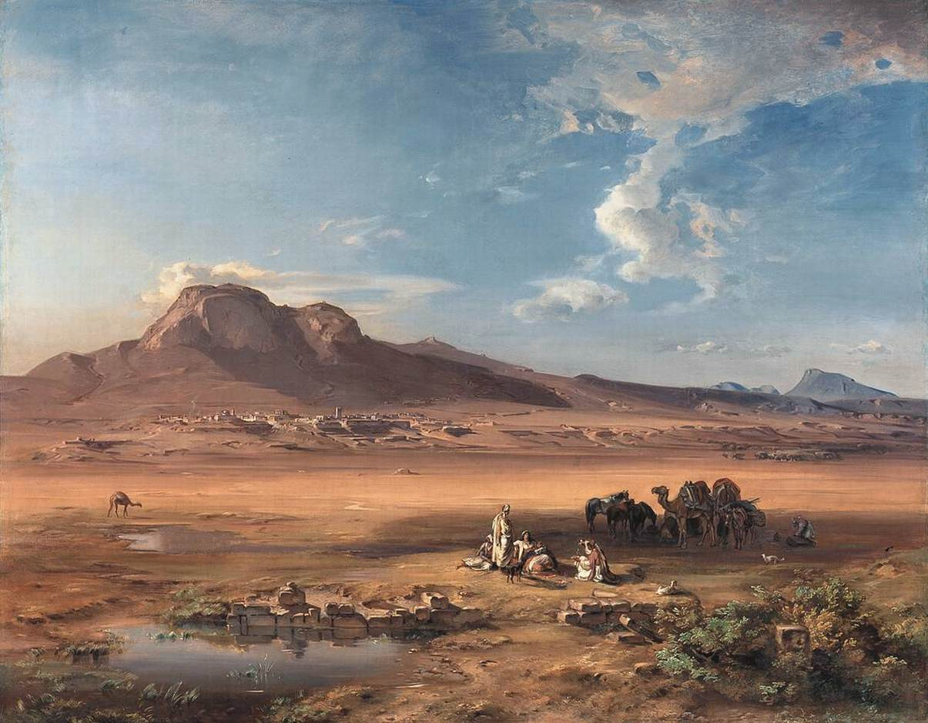
“Corinth with Acrocorinth”
By Carl Anton Joseph Rottmann, 1847

Slide 8
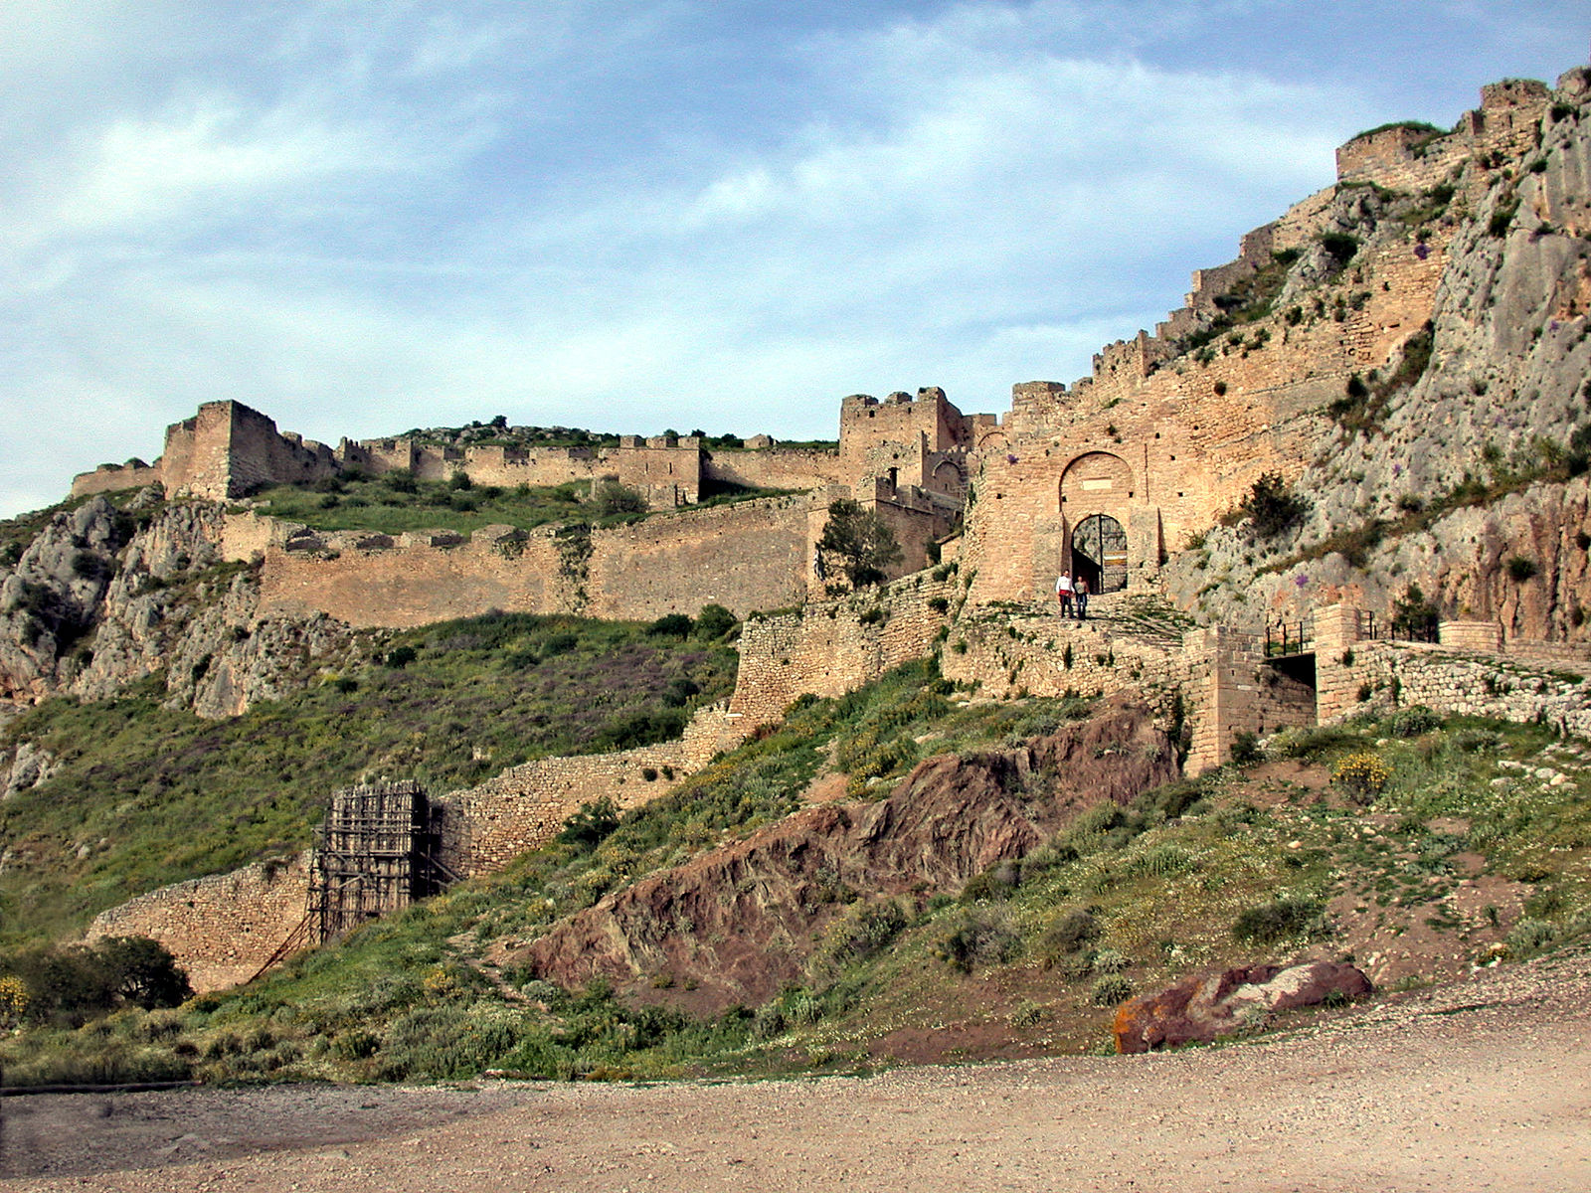
The walled gates of Acrocorinth

Slide 9
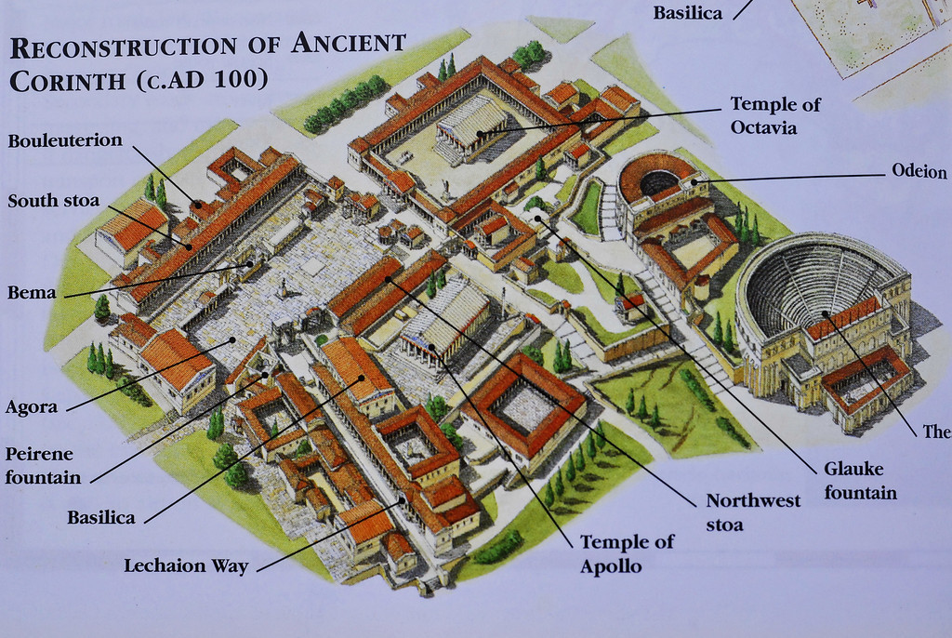
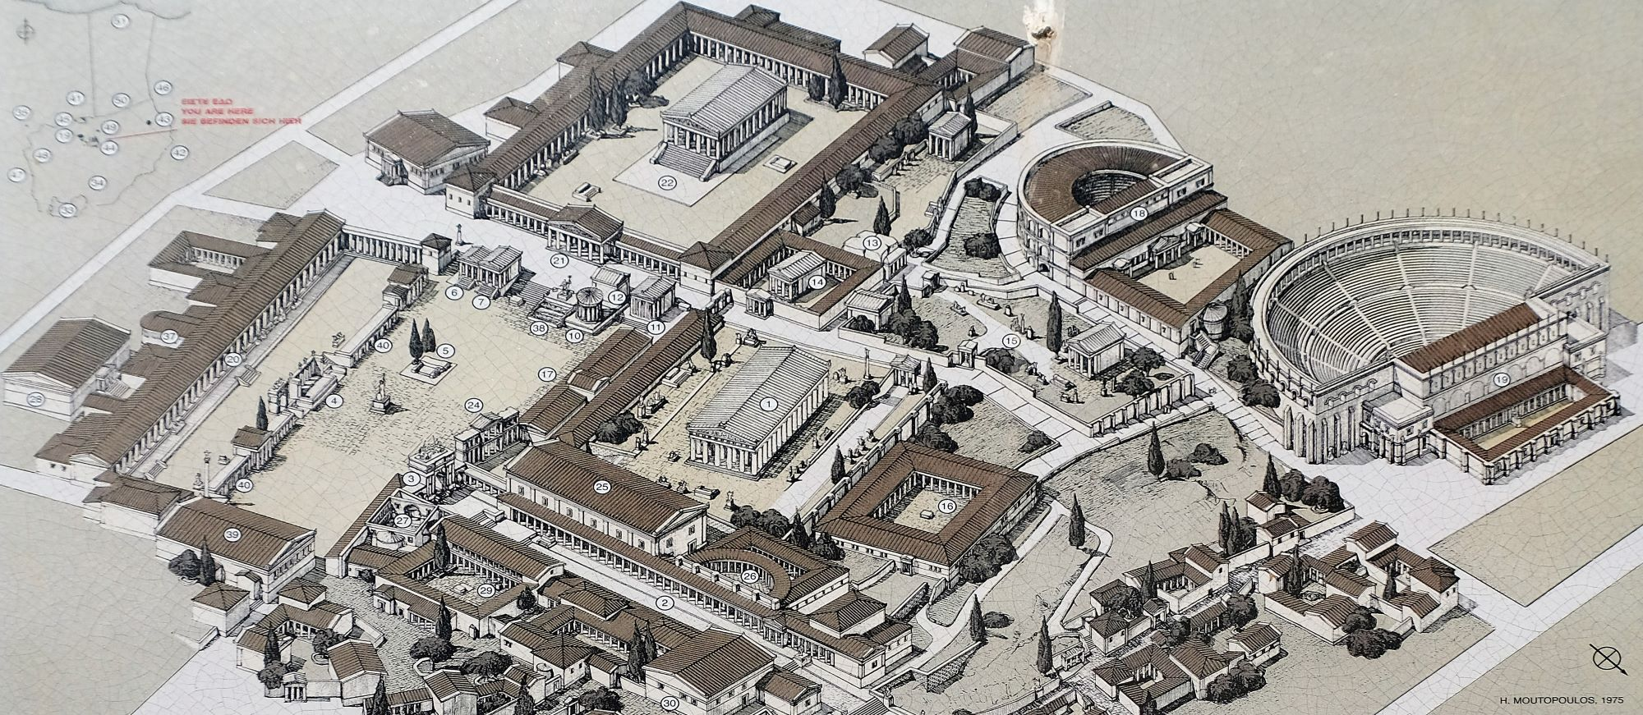
Corinth as it would have appeared around the time of the Apostle Paul

Slide 10
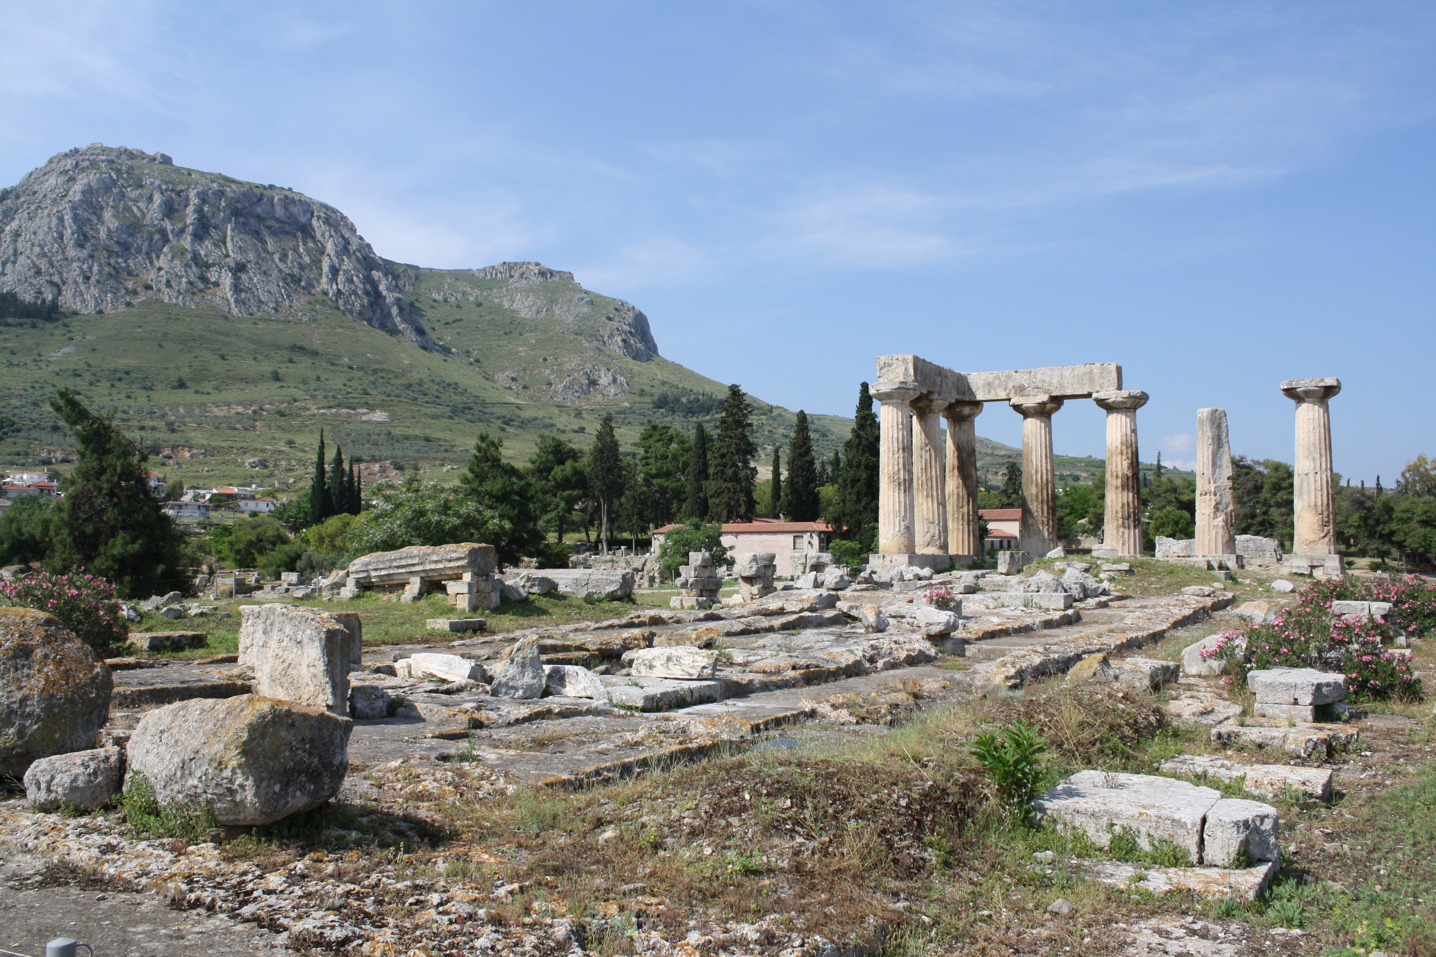
Apollo Temple
Supported by 38 columns, only 7 of which are still in place

Slide 11
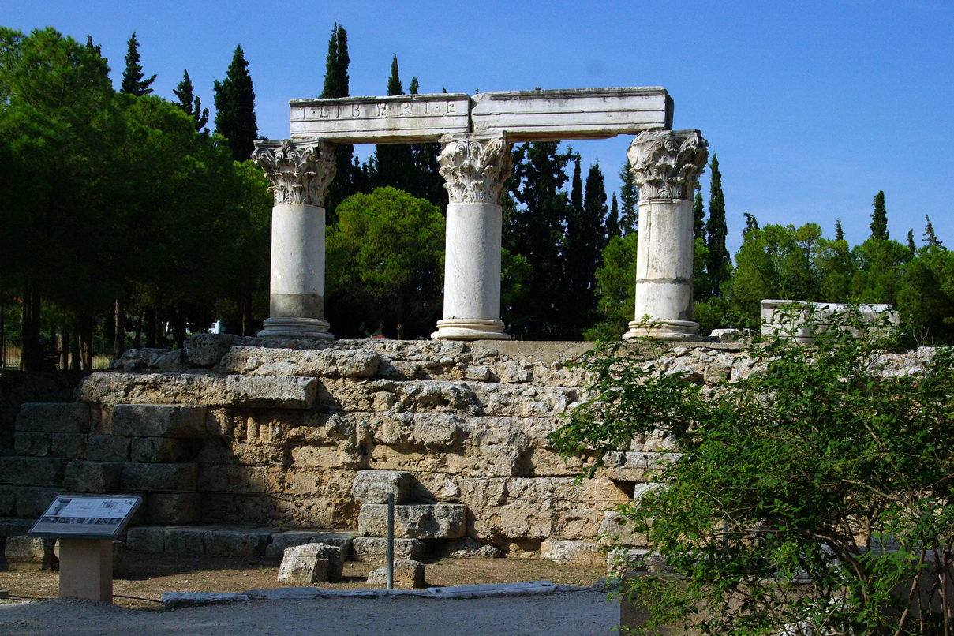
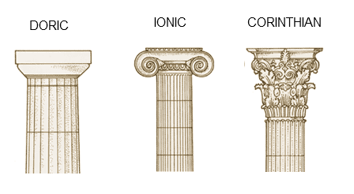
Corinthian order columns in ancient Corinth

Slide 12
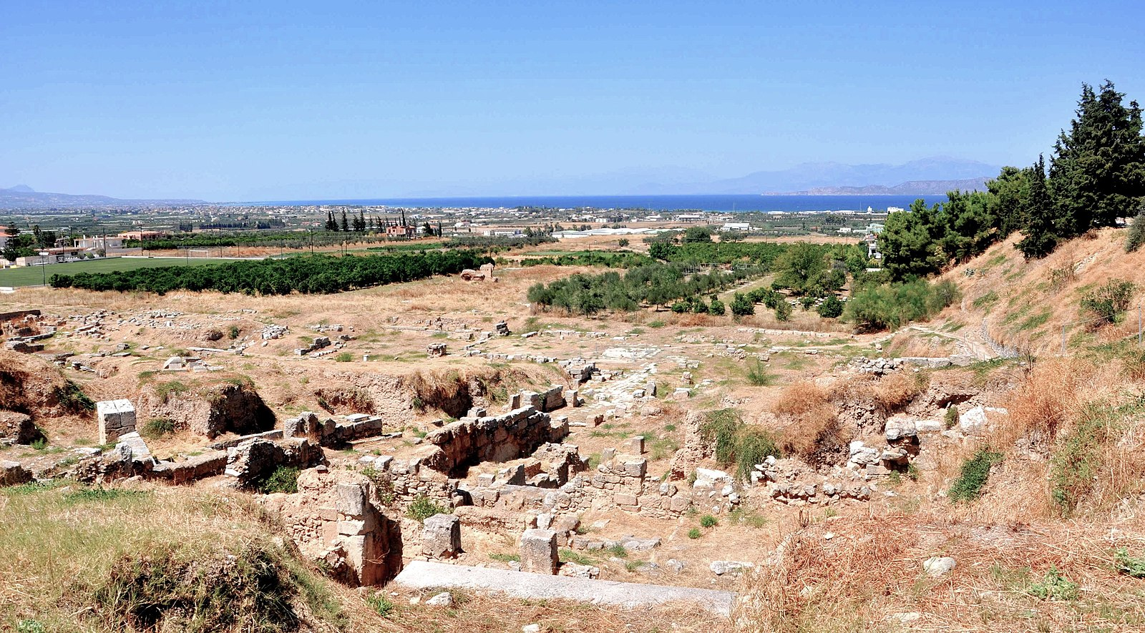
Site of Ancient Theater built in 5th c. BC.
The Theater could seat around 15,000

Slide 13
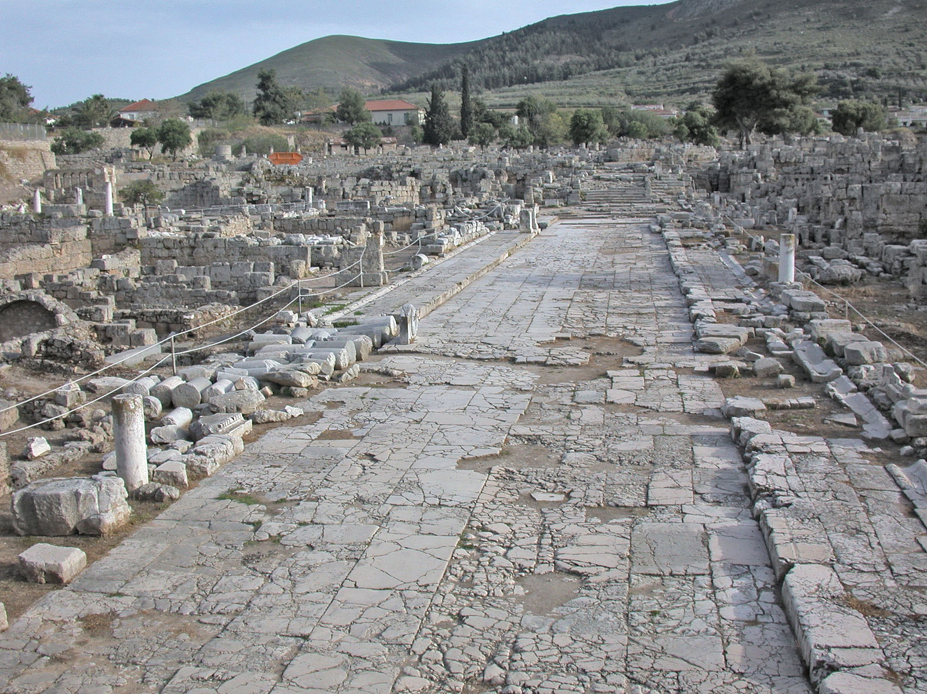
Street in ancient Corinth

Slide 14
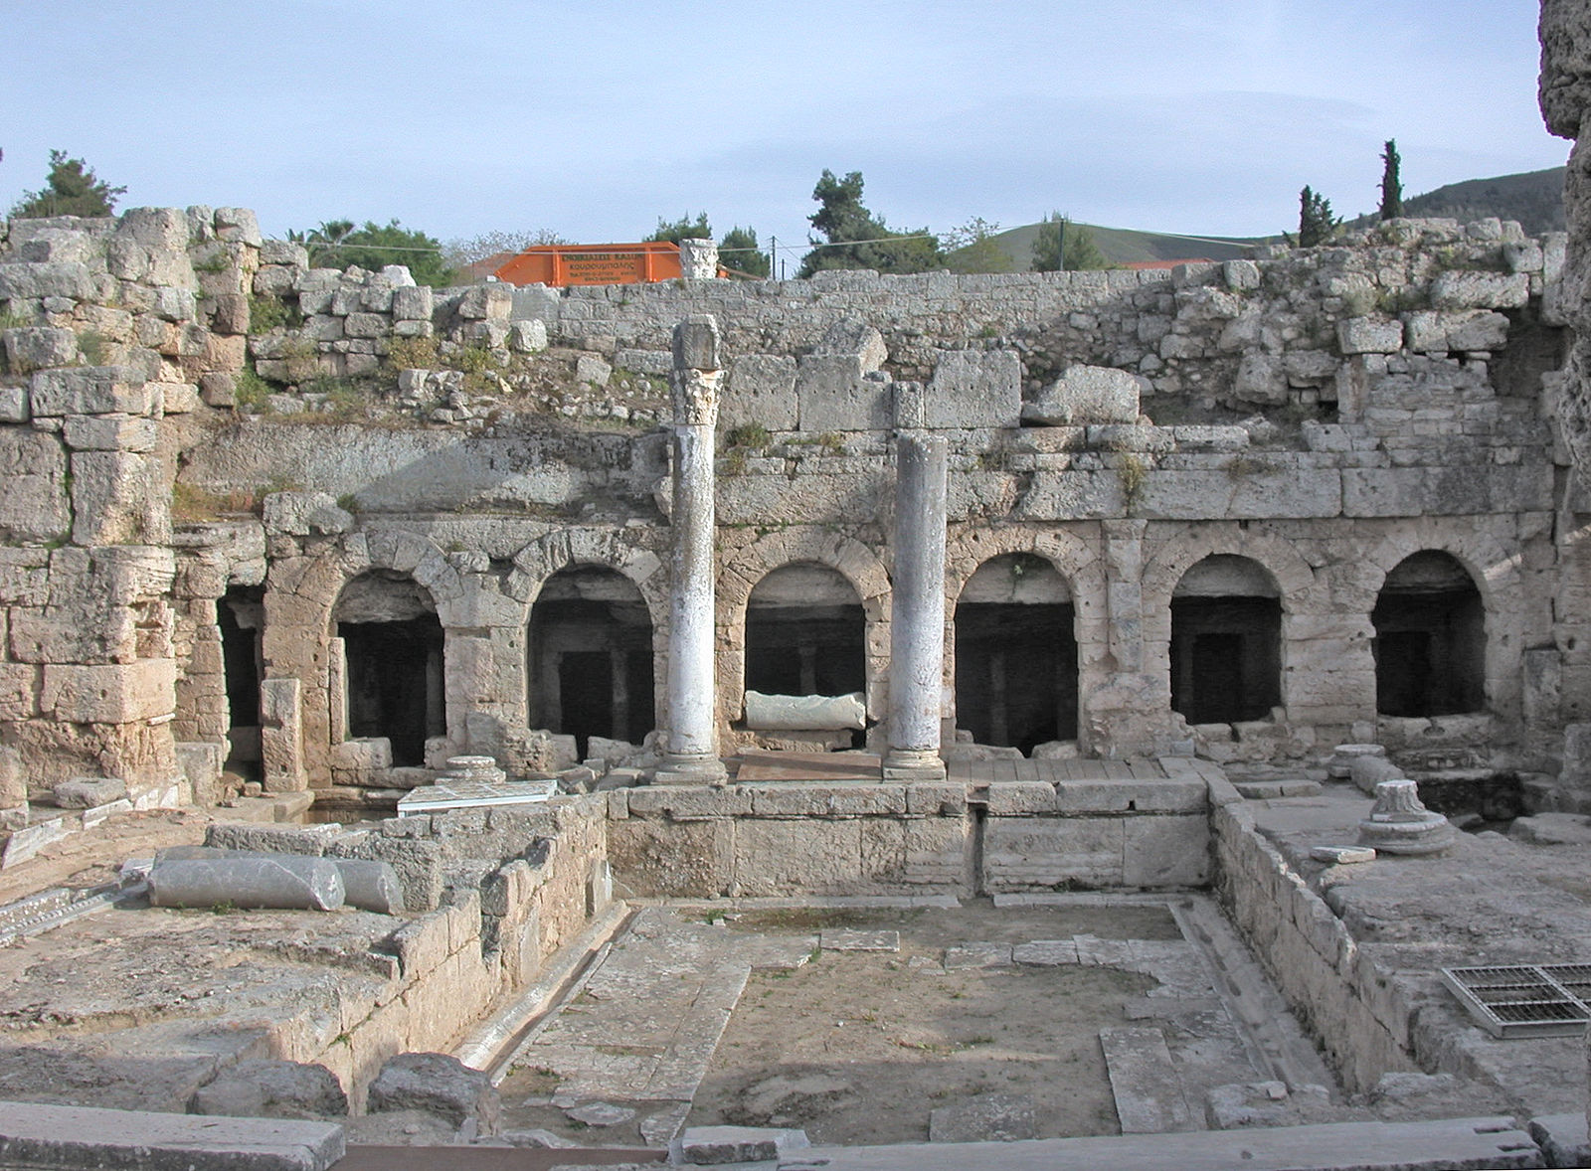
Pirene Fountain

Slide 15
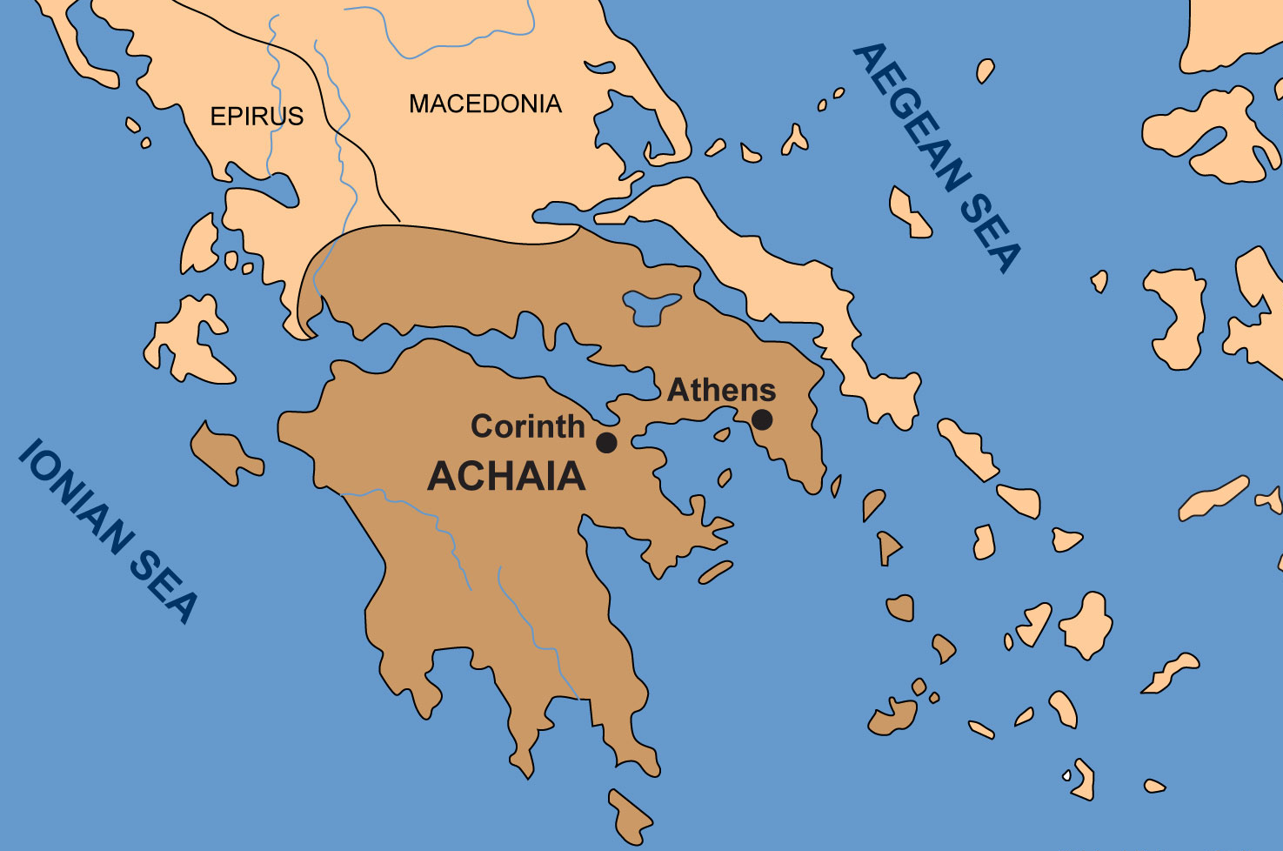

Slide 16
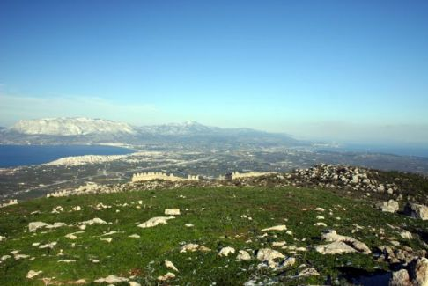
[the Adriatic Sea] Corinth Isthmus [the Aegean Sea]

Slide 17
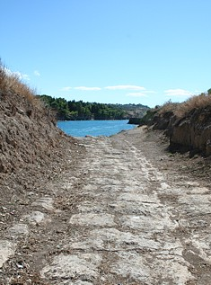
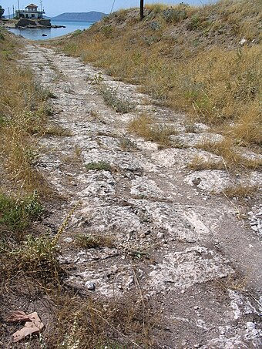
Ancient Path of “Diolkos”

Slide 18
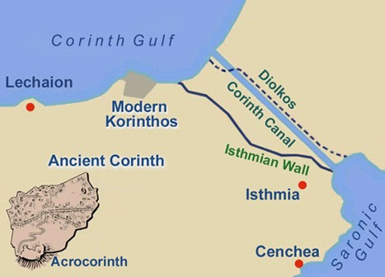
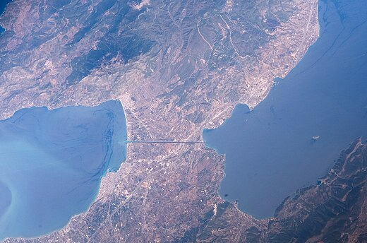
One of the most strategic locations in the Roman world was the Isthmus of Corinth. This narrow neck of land between the Corinthian Gulf and the Saronic Gulf guaranteed its continued commercial prosperity. The transit across this isthmus avoided the long, risky voyage around the rocky, storm-tossed capes at the south of the Peloponnesus. It was literally the crossroad of the world where the north-south trade routes intersected the east-west traffic. Corinth became one of the most dominant cultural centers of its day.
Satellite View of Canal
Finished in 1893

Slide 19
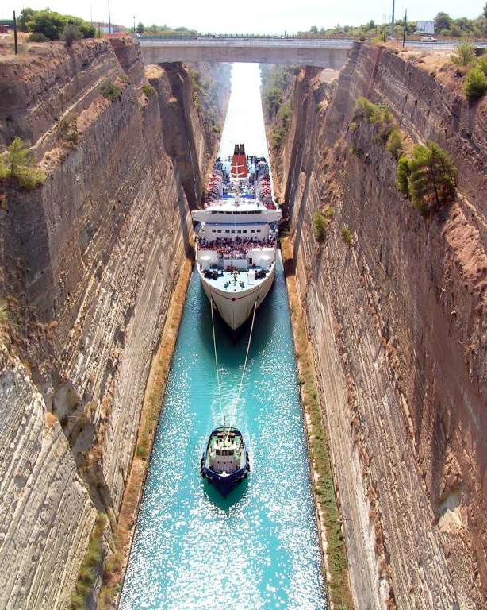

Slide 20
In the Apostle Paul’s day, Corinth had several nicknames. It was known as Carnal Corinth, Sin City, or Vanity Fair. To “corinthianize” a person was to corrupt a person. It was to take him beyond his moral limits. People went to Corinth to be corinthianized - it was like a rite of passage. There was no greater insult that could be given a woman than to be called a Corinthian.

Slide 21
Acts 18:1 & 4
1 After these things [Paul] left Athens and went to Corinth…
2 And he was reasoning in the synagogue every Sabbath and trying to persuade Jews and Greeks.

Slide 22
In preaching the gospel in Corinth, the apostle followed a course different from that which had marked his labors at Athens. While in the latter place [Athens], he had sought to adapt his style to the character of his audience; he had met logic with logic, science with science, philosophy with philosophy. As he thought of the time thus spent, and realized that his teaching in Athens had been productive of but little fruit, he decided to follow another plan of labor in Corinth in his efforts to arrest the attention of the careless and the indifferent. He determined to avoid elaborate arguments and discussions, and "not to know anything" among the Corinthians "save Jesus Christ, and Him crucified." He would preach to them "not with enticing words of man's wisdom, but in demonstration of the Spirit and of power." 1 Corinthians 2:2, 4. (Acts of the Apostles, page 245)

Slide 23
1 Corinthians 2:1 & 2
1 And when I came to you, brethren, I did not come with superiority of speech or of wisdom, proclaiming to you the testimony of God.
2 For I determined to know nothing among you except Jesus Christ, and Him crucified

Slide 24
1 Corinthians 1:22-24
22 For indeed the Jews ask for signs and Greeks search for wisdom;
23 but we preach Christ crucified, to Jews a stumbling block and to Gentiles foolishness,
24 but to those who are the called, both Jews and Greeks, Christ the power of God and the wisdom of God.

Slide 25
“But to Paul the cross was the one object of supreme interest.” (Acts of the Apostles, page 245)
But God forbid that I should boast except in the cross of our Lord Jesus Christ, by whom the world has been crucified to me, and I to the world .” Galatians 6:14

Slide 26
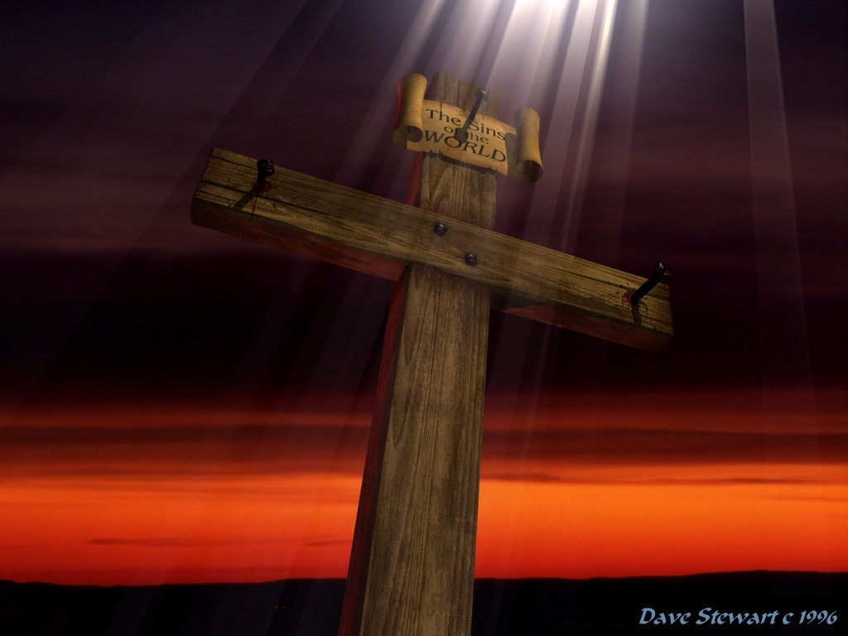
In the cross of Christ I glory, Towering o’er the wrecks of time; All the light of sacred story Gathers round its head sublime.

Slide 27
How is Christ’s cross “the power of God”?
Romans 1:16
Shows us the clearest evidence of the world’s guilt
We see the strongest proof of God’s hatred of sin
We behold the glorious exhibition of God’s reconciling love
In the cross we see the way to victory and abiding in Christ

Slide 28
“Exalting the Cross”
“If those who today are teaching the word of God, would uplift the cross of Christ higher and still higher, their ministry would be far more successful. If sinners can be led to give one earnest look at the cross, if they can obtain a full view of the crucified Savior, they will realize the depth of God’s compassion and the sinfulness of sin.”
Acts of the Apostles, page 209

Slide 29
“Exalting the Cross”
“Christ’s death proves God’s great love for man. It is our pledge of salvation. To remove the cross from the Christian would be like blotting the sun from the sky. The cross brings us near to God, reconciling us to Him…
Acts of the Apostles, page 209

Slide 30
“Exalting the Cross”
“Without the cross, man could have no union with the Father. On it depends our every hope. From it shines the light of the Savior’s love, and when at the foot of the cross the sinner looks up to the One who died to save him, he may rejoice with fullness of joy, for his sins are pardoned. Kneeling in faith at the cross, the sinner has reached the highest place to which man can attain.”
Acts of the Apostles, page 209-10

Slide 31
MY TESTIMONY
1 Corinthians 1:30-31 (KJV)
30 But of him are ye in Christ Jesus, who of God is made unto us wisdom, and righteousness, and sanctification, and redemption:
31 That, according as it is written, He that glorieth, let him glory in the Lord.

Slide 32
Exalting Jesus and His Cross
At the Cross –163
Burdens are Lifted at Calvary – 476
I Am Going to Calvary – 288
In the Cross of Christ I Glory – 237
O Sacred Head Now Wounded – 156
The Old Rugged Cross – 159
When I Survey the Wondrous Cross – 155
Lead Me to Calvary – 317
Near the Cross – 312
The Way of the Cross Leads Home

Slide 33
“At The Cross”
Hymn 163
Used by Permission. CCLI Lic. #233584

Slide 34
Alas! and did my Savior bleed And did my Sovereign die? Would He devote that sacred head For such a worm as I?
At the cross, at the cross
Where I first saw the light, And the burden of my heart rolled away, It was there by faith I received my sight, And now I am happy all the day!
1

Slide 35
Was it for crimes that I had done He groaned upon the tree? Amazing pity! grace unknown! And love beyond degree!
At the cross, at the cross
Where I first saw the light, And the burden of my heart rolled away, It was there by faith I received my sight, And now I am happy all the day!
2

Slide 36
But drops of grief can ne’er repay The debt of love I owe: Here, Lord, I give my self away ‘Tis all that I can do.
At the cross, at the cross
Where I first saw the light, And the burden of my heart rolled away, It was there by faith I received my sight, And now I am happy all the day!
3

Slide 37
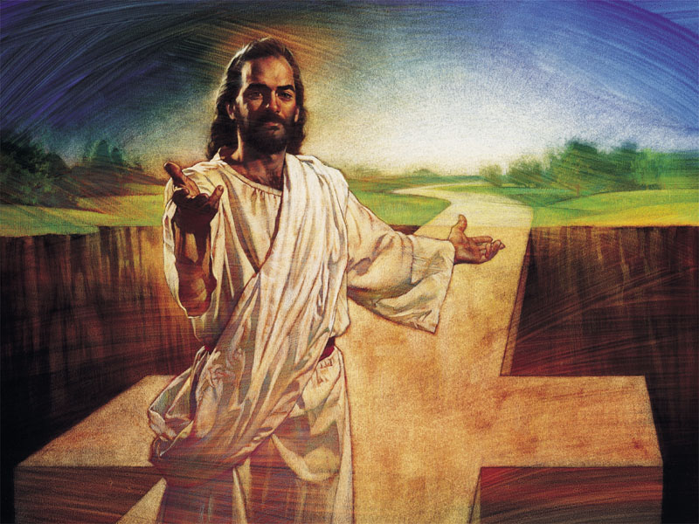

Slide 38
Benediction
2 Corinthians 13:14
“The grace of the Lord Jesus Christ, and the love of God, and the fellowship of the Holy Spirit, be with you all.”

Slide 41
Marvelous Grace
Hymn 109
Used by Permission. CCLI Lic. #233584

Slide 42
1
Marvelous grace of
our loving Lord,
Grace that exceeds
our sin and our guilt!
Yonder on Calvary’s
mount out-poured--
There where the blood
of the Lamb was spilt.

Slide 43
refrain
Grace, grace, God’s grace,
Grace that will pardon and cleanse within;
Grace, grace, God’s grace,
Grace that is greater than all our sin!

Slide 44
2
Sin and despair, like
the sea-waves cold,
Threaten the soul with
infinite loss;
Grace that is greater--
yes, grace untold--
Points to the Refuge,
the mighty Cross.

Slide 45
refrain
Grace, grace, God’s grace,
Grace that will pardon and cleanse within;
Grace, grace, God’s grace,
Grace that is greater than all our sin!

Slide 46
3
Marvelous, infinite,
matchless grace,
Freely bestowed on
all who believe!
You that are longing
to see His face,
Will you this moment
His grace receive?

Slide 47
refrain
Grace, grace, God’s grace,
Grace that will pardon and cleanse within;
Grace, grace, God’s grace,
Grace that is greater than all our sin!

